Slide 1
Course Details
DATAVIS 300: Decision Making in Data Visualization
Certificate in Data Visualization
Instructor: Ashley Howard alh63gu@gmail.com
TA: Jay Wang jayfwang2013@gmail.com
Downtown Seattle #405/Online
Tuesday 6-9 PM,
4/5/2016 – 6/14/2016
Note: No class 4/19

Slide 2
My Story Course Introduction Today’s Lesson: The Irony of the Mind Discussion Homework

Slide 3
My Story.

Slide 4
My Story Course Introduction Today’s Lesson: The Irony of the Mind Discussion Homework

Slide 5
1. Your Name 2. Why did you enroll in the certificate? 3. What data viz tool are you most comfortable with? 4. What do you still want to learn?
Discussion

Slide 6
Course Details
DATAVIS 300: Decision Making in Data Visualization
Certificate in Data Visualization
Instructor: Ashley Howard alh63gu@gmail.com
TA: Jay Wang jayfwang2013@gmail.com
Downtown Seattle #405/Online
Tuesday 6-9 PM,
4/5/2016 – 6/14/2016
Note: No class 4/19

Slide 7
Course Structure
Each lesson will be roughly split into 3rds:
Lesson
Case Study
Project Progress
Homework: Additional Resources, Video Case Studies
Notes:
Attendance - Options may be available for remote attendance for in person students.
Assignments - These assignments ensure you are making progress on your Capstone Visualization. The required assignments are elements of the capstone visualization
Capstone Visualization

Slide 8
Grading
Attendance – All Students must attend at least 80% of the sessions.
Assignments – There are ficer required and five optional assignments.
Capstone Visualization – Students must identify a decision making challenge, and both design and build a visualization to assist someone to make a decision.
Presentation – Students will have 10 minutes to present their visualization to the class.
Notes:
Attendance - Options may be available for remote attendance for in person students.
Assignments - These assignments ensure you are making progress on your Capstone Visualization. The required assignments are elements of the capstone visualization
Capstone Visualization

Slide 9
Grading
A completed capstone Visualization project will include the following elements:
Initial Design Requirement
Capstone Visualization
Presentation
Post-Mortem
Technologies: Due to my strong background with Tableau, I can provide you the most feedback and assistance if you choose to use Tableau. You may use another technology for your final project.
Notes:
You learn through projects, not tutorials. Pick a project, then learn the tools you need to complete it. A common question I hear about learning to code or get started in data visualization is “What language/tools/software should I learn?” The answer to that question is always “What are you trying to do?” Depending on the specific thing you want to do (analyze a data set? create a bar chart? scrape a website?), the tools and languages and programs will change. So I think it’s super important to remember that the project determines the tools, and it’s also how you learn. One more piece of advice: even if you feel stuck and frustrated, if you struggle for hours and feel like you’re not making progress, don’t worry: YOU ARE LEARNING. Take a look at Make It Stick: The Science of Successful Learning if you want evidence that the best way to learn is through the repeated struggle to solve problems by ourselves.
Try to always do something specific and unique to the data you are working with. Ask the question: What is something that could ONLY be done with this information? Let the answer guide you. Many of my favorite and most fulfilling projects have been exploiting the uniqueness of the data to do something no one has done before.

Slide 10
Grading
The capstone visualization will be critiqued on the following:
Has a clear purpose.
Demonstrates restraint, including only relevant content.
Analysis is sound mathematically and logically.
Uses appropriate visual structures.
Has useful formatting, integrating Visual Best Practices.
Presentation: Students will present their visualization to the class. Each student will have 10 minutes to present their work (5 minute presentation, 5 minutes for questions).

Slide 11
Course Topics (and Assignments)
April 5:
Week 1 – Introduction to Visualization in Decision Making
Introductions and course expectations
The Irony of the Mind
Optional Assignment #1: Critique a visualization, complete by 4/11. Choose a visualization and provide a critique based on the principles discussed in class.

Slide 12
Course Topics (and Assignments)
April 12:
Week 2 – Role of Visualization in Decision Making
Data-driven decision making
Cycle of Visual Analysis
Optional Assignment #2: VizWiz
Final Project Milestone: Identify the decision you want to create a tool to visualize in your capstone project. Students who choose something they are passionate about tend to learn the most from the project.

Slide 13
Course Topics (and Assignments)
April 19:
No Class
Required Assignment #1: Complete the Design Requirements Document by 4/25.
Final Project Milestone: Identify and select a data set.

Slide 14
Course Topics (and Assignments)
April 26:
Week 3 – Building Data Models
Using Visualizations to Understand Data
Structuring Data for Analysis
Preparing Data: Cleaning + ETL
Optional Assignment #3: Build a concept board.
Final Project Milestone: You should have begun exploring your data.

Slide 15
Course Topics (and Assignments)
May 3:
Week 4 – Designing Impactful Visualizations
User-Centered Design
Leveraging a story structure for visualization presentation.
Final Project Milestone: You should have an understanding about the nuances of your data set and be able to identify the measures and dimensions of your final visualization.

Slide 16
Course Topics (and Assignments)
May 10:
Week 5 – Communicating to Your User
Visualization best practices
Fit & Finish Tips and Tricks
Required Assignment #2: Submit your first pass of your Visualization to the discussion board for feedback from your instructor and peers. Complete by 5/13.

Slide 17
Course Topics (and Assignments)
May 17:
Week 6 – Case Studies in Data Visualizations, part 1
Mobile Analytics and Decision Making
Guest Speaker: From PATH’s Eliminate Malaria in Zambia project
Optional Assignment #3: Review at least two of your peers’ visualizations on the course discussion boards, complete by 5/20.

Slide 18
Course Topics (and Assignments)
May 24:
Week 6 – Decision Making in the Business Environment
Roles of IT and Business in Data Analysis
Hurdles to adopting Data based Decision Making
Guest Speaker: Jesse Lynch, Director of BI at T-Mobile
Optional Assignment #4: Administer and Publish to a Tableau Online Site, complete by 5/30.
Final Project Milestone: Integrate feedback from your peers into your visualization.

Slide 19
Course Topics (and Assignments)
May 31:
Week 8 – Case Studies in Data Visualizations, part 2
Building tools for Decision Making
Guest Speaker: Zach Ahrens, Tableau Consultant at American Express
Final Project Milestone: Finish compiling your presentation.

Slide 20
Course Topics (and Assignments)
June 7:
Week 9 – Presentations/Future of Data Visualization
Presentations
Trends in Data Visualization Research and Development
Guest Speaker: Jock Mackinlay, VP of Research and Development at Tableau
Required Assignment #3: Submit Capstone Visualization and Final Presentation, due 6/7.
Notes:
One person of note is my manager, Dr. Jock Mackinlay, who actually helped invent the field of computerized Information Visualization 30 years ago at Xerox PARC.

Slide 21
Course Topics (and Assignments)
June 14:
Week 10 - Presentations/Growing Beyond this Course
Presentations
Translating the lessons from this course into your jobs/career.
Required Assignment #4: Post Mortem, due 6/15. Following your presentation, critique your visualization, articulate room for improvements, and how you would approach the project differently in the future.

Slide 22
My Story Course Introduction Today’s Lesson: The Irony of the Mind Discussion Homework

Slide 23
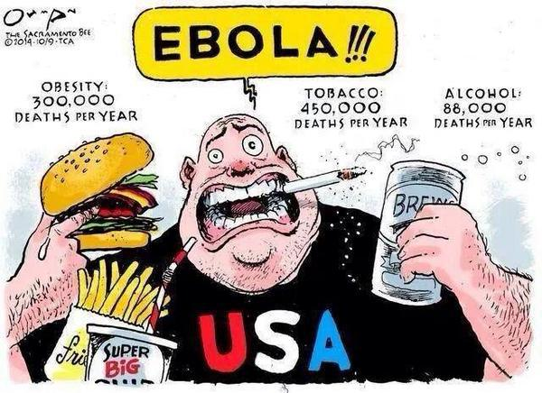
HEURISTICS
Notes:
For a long time, researchers and economists believed that humans made logical, well-considered decisions. In recent decades, however, researchers have uncovered a wide range of mental errors that derail our thinking. Sometimes we make logical decisions, but there are many times when we make emotional, irrational, and confusing choices.
A psychological perspective does not start from the assumption that people are fundamentally irrational. Rather, it emphasizes a different logic: a logic that meets the challenges we have evolved to face. For much of our evolution we have faced an environment with major differences from the modern business world. We have developed a range of cognitive mechanisms to cope with adverse environments in which resources are scarce.
These mechanisms include a range of simplifying and confidence-sustaining mental short cuts (heuristics) that help us to make quick decisions when pausing to undertake a full analysis would be unwise. While these ways of thinking are not the same as rigorous logic or formally rational reasoning, they are well suited to fast-paced intuitive judgements and actions. However, these evolved modes of thinking also create some major traps.
Let’s talk about the mental errors that show up most frequently in our lives and break them down in easy-to-understand language.
Here are five common mental errors that sway you from making good decision

Slide 24
Notes:
Framing Bias
The way in which a problem is framed can have a significant effect on how you make decisions. Medical decisions can be affected by whether outcomes are framed as likelihood of deaths or of saving patients. Financial decisions can be affected by whether you see yourself in a position of loss or gain. In a position of gain we tend to become risk averse; in a position of loss we will tend to take risks to avoid or recover losses. You may know people who are good at using this to their advantage; they exert influence by framing choices so that others will choose the option they prefer.
Framing effects can be quite subtle and even affect our recall of events. For example, in one study, groups of students were shown a film of a car accident. Each group of students was shown the same film clip and then asked ‘How fast were the cars going when they ---- each other?’ where ‘----’ was a different word for each group, variously ‘smashed into’, ‘collided into’, ‘bumped into’, ‘hit’ and ‘contacted’. The table below shows the average speed estimated by each group.
Those who were asked the ‘smashed’ question were also more likely to believe they had seen broken glass in the film clip than those who were asked the ‘hit’ question. There was no broken glass.
Car accident study sourced from EF Loftus and JC Palmer, ‘Reconstruction of automobile destruction: an example of the interaction between language and memory’, Journal of Learning and Verbal Behavior, 1974.

Slide 25
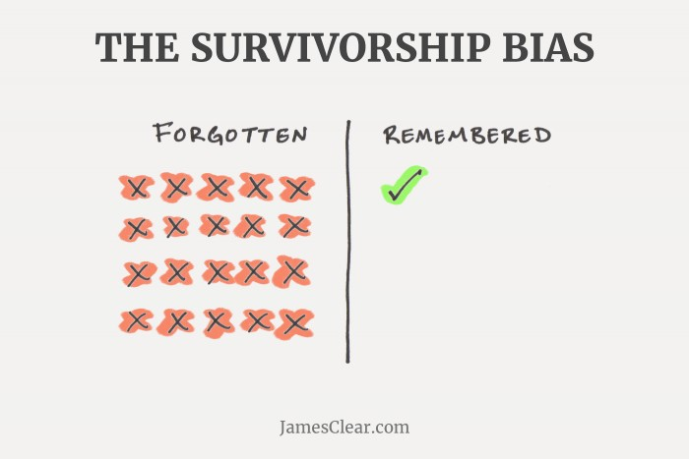
Notes:
1. Survivorship Bias.
Nearly every popular online media outlet is filled with survivorship bias these days. Anywhere you see articles with titles like “8 Things Successful People Do Everyday” or “The Best Advice Richard Branson Ever Received” or “How LeBron James Trains in the Off-Season” you are seeing survivorship bias in action.
Survivorship bias refers to our tendency to focus on the winners in a particular area and try to learn from them while completely forgetting about the losers who are employing the same strategy.
There might be thousands of athletes who train in a very similar way to LeBron James, but never made it to the NBA. The problem is nobody hears about the thousands of athletes who never made it to the top. We only hear from the people who survive. We mistakenly overvalue the strategies, tactics, and advice of one survivor while ignoring the fact that the same strategies, tactics, and advice didn’t work for most people.
Another example: “Richard Branson, Bill Gates, and Mark Zuckerberg all dropped out of school and became billionaires! You don’t need school to succeed. Entrepreneurs just need to stop wasting time in class and get started.”
It’s entirely possible that Richard Branson succeeded in spite of his path and notbecause of it. For every Branson, Gates, and Zuckerberg, there are thousands of other entrepreneurs with failed projects, debt-heavy bank accounts, and half-finished degrees. Survivorship bias isn’t merely saying that a strategy may not work well for you, it’s also saying that we don’t really know if the strategy works well at all.
When the winners are remembered and the losers are forgotten it becomes very difficult to say if a particular strategy leads to success.

Slide 26
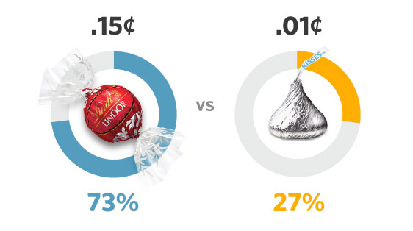
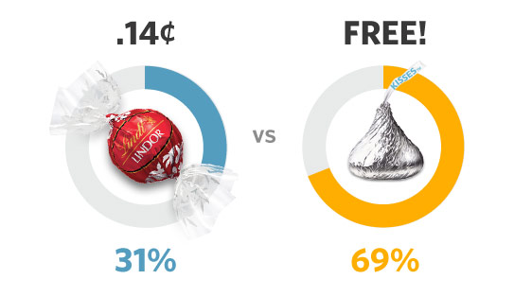
Notes:
2. Loss Aversion.
Loss aversion refers to our tendency to strongly prefer avoiding losses over acquiring gains. Research has shown that if someone gives you $10 you will experience a small boost in satisfaction, but if you lose $10 you will experience a dramatically higher loss in satisfaction. Yes, the responses are opposite, but they are not equal in magnitude.
Our tendency to avoid losses causes us to make silly decisions and change our behavior simply to keep the things that we already own. We are wired to feel protective of the things we own and that can lead us to overvalue these items in comparison with the options.
For example, if you buy a new pair of shoes it may provide a small boost in pleasure. However, even if you never wear the shoes, giving them away a few months later might be incredibly painful. You never use them, but for some reason you just can’t stand parting with them. Loss aversion.
Despite it's overuse, "free" is indeed a very special concept, and according to research by Dan Ariely, our preference for it appears to be almost hardwiredinto our brains.
In an experiment described in his book Predictably Irrational, Ariely tells the tale of a battle between a Hershey's Kiss and a Lindt chocolate truffle. If you are unfamiliar with Lindt truffle's, they are a magnitude more expensive than a simple Hershey's Kiss, and generally considered to be much richer in taste.
In his tests, Ariely sought to reveal what differing levels of price would do to subjects choices between either the Kiss or the truffle.
In the first test, truffles could be bought for 15 cents (about half their usual cost), or subjects could choose a Kiss for 1 cent. Nearly 3/4th of the subjects chose the truffle, since they were getting a great deal and a superior product.
In the next test, the cost of each item was reduced by a single cent: 14 cents for the truffle, and 0 (free) for the Kiss. Although the difference in price remained exactlythe same (14 cents), the behavior of the subjects changed completely.
Subjects now chose the Kiss more than 2/3rd's of the time over the truffles.
Ariely's conclusions point to loss aversion and our susceptibility for "low-hanging fruit" as the culprits. That is ...
We seek to avoid losses more-so than attaining gains, even when the loss is actually a great deal (the truffles being half-priced). We also have a tendency to seek out things that can be gained with minimal effort or expenditure.In an additional showcase of the power of the word "free", Ariely covers an intriguing example from an international promotion that was made over at Amazon.com.
During a time when Amazon launched a free shipping promotion for every customer who purchased a 2nd book, every single country except France had shown a huge jump in sales.
What was it with the French? Did they not like books? Was the marketing strategy coming up short? Were the French consumers not all that impressed with the deal?
None of the above: as it turns out, in France the promotion had a slight alteration. Instead of the shipping being "FREE!" with a second book, it was only reduced down to a single franc (about 20 cents).
When it comes to buying ~$15 books, the change was negligible in relation to the final cost.
When it came to performance though, it mattered big time: with the 1 franc charge attached to the French promotion, Amazon saw no (that's ZERO) increase in sales.
When things were fixed, the sales jumped to the results achieved in every other country, a notable display of the power of the word "free".
When utilizing "free" in your own business, the only things you want to avoid are false promises and turning your customers into "bargain hunters" rather than value seekers.

Slide 27
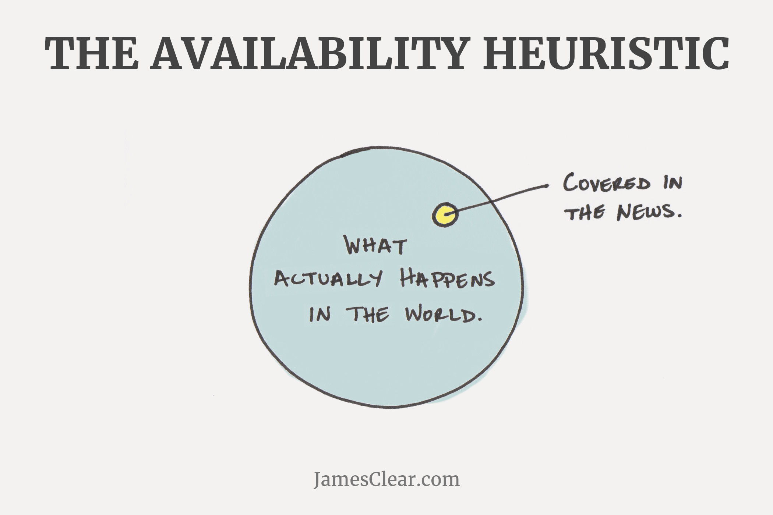
Notes:
3. The Availability Heuristic.
The Availability Heuristic refers to a common mistake that our brains make by assuming that the examples which come to mind easily are also the most important or prevalent things.
For example, research by Steven Pinker at Harvard University has shown that we are currently living in the least violent time in history. There are more people living in peace right now than ever before. The rates of homicide, rape, sexual assault, and child abuse are all falling.
Most people are shocked when they hear these statistics. Some still refuse to believe them. If this is the most peaceful time in history, why are there so many wars going on right now? Why do I hear about rape and murder and crime every day? Why is everyone talking about so many acts of terrorism and destruction?
Welcome to the availability heuristic.
The answer is that we are not only living in the most peaceful time in history, but also the best reported time in history. Information on any disaster or crime is more widely available than ever before. A quick search on the Internet will pull up more information about the most recent terrorist attack than any newspaper could have ever delivered 100 years ago.
The overall percentage of dangerous events is decreasing, but the likelihood that you hear about one of them (or many of them) is increasing. And because these events are readily available in our mind, our brains assume that they happen with greater frequency than they actually do.
We overvalue and overestimate the impact of things that we can remember and we undervalue and underestimate the prevalence of the events we hear nothing about.

Slide 28
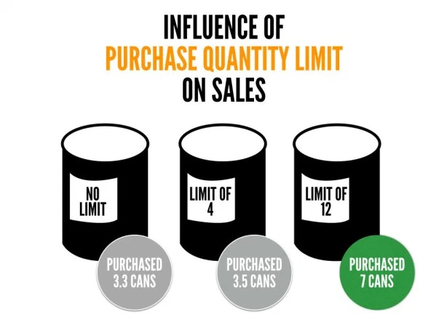
Notes:
4. Anchoring.
There is a burger joint close to my hometown that is known for gourmet burgers and cheeses. On the menu, they very boldly state, “LIMIT 6 TYPES OF CHEESE PER BURGER.”
My first thought: This is absurd. Who gets six types of cheese on a burger?
My second thought: Which six am I going to get?
I didn’t realize how brilliant the restaurant owners were until I learned about anchoring. You see, normally I would just pick one type of cheese on my burger, but when I read “LIMIT 6 TYPES OF CHEESE” on the menu, my mind was anchored at a much higher number than usual.
Most people won’t order six types of cheese, but that anchor is enough to move the average up from one slice to two or three pieces of cheese and add a couple extra bucks to each burger. You walk in planning to get a normal meal. You walk out wondering how you paid $14 for a burger and if your date will let you roll the windows down on the way home.
This effect has been replicated in a wide range of research studies and commercial environments. For example, business owners have found that if you say “Limit 12 per customer” then people will buy twice as much product compared to saying, “No limit.”
In one research study, volunteers were asked to guess the percentage of African nations in the United Nations. Before they guessed, however, they had to spin a wheel that would land on either the number 10 or the number 65. When volunteers landed on 65, the average guess was around 45 percent. When volunteers landed on 10, the average estimate was around 25 percent. This 20 digit swing was simply a result of anchoring the guess with a higher or lower number immediately beforehand.
Perhaps the most prevalent place you hear about anchoring is with pricing. If the price tag on a new watch is $500, you might consider it too high for your budget. However, if you walk into a store and first see a watch for $5,000 at the front of the display, suddenly the $500 watch around the corner seems pretty reasonable. Many of the premium products that businesses sell are never expected to sell many units themselves, but they serve the very important role of anchoring your mindset and making mid-range products appear much cheaper than they would on their own.

Slide 30
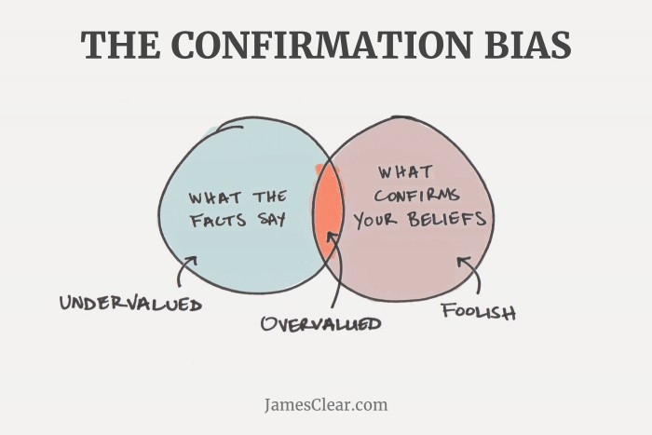
Notes:
5. Confirmation Bias.
The Grandaddy of Them All. Confirmation bias refers to our tendency to search for and favor information that confirms our beliefs while simultaneously ignoring or devaluing information that contradicts our beliefs.
For example, Person A believes climate change is a serious issue and they only search out and read stories about environmental conservation, climate change, and renewable energy. As a result, Person A continues to confirm and support their current beliefs.
Meanwhile, Person B does not believe climate change is a serious issue, and they only search out and read stories that discuss how climate change is a myth, why scientists are incorrect, and how we are all being fooled. As a result, Person B continues to confirm and support their current beliefs.
Changing your mind is harder than it looks. The more you believe you know something, the more you filter and ignore all information to the contrary.
WAITERS & TIPS
It is not natural for us to formulate a hypothesis and then test various ways to prove it false. Instead, it is far more likely that we will form one hypothesis, assume it is true, and only seek out and believe information that supports it. Most people don’t want new information, they want validating information.
http://www.nytimes.com/interactive/2015/07/03/upshot/a-quick-puzzle-to-test-your-problem-solving.html?_r=0

Slide 31
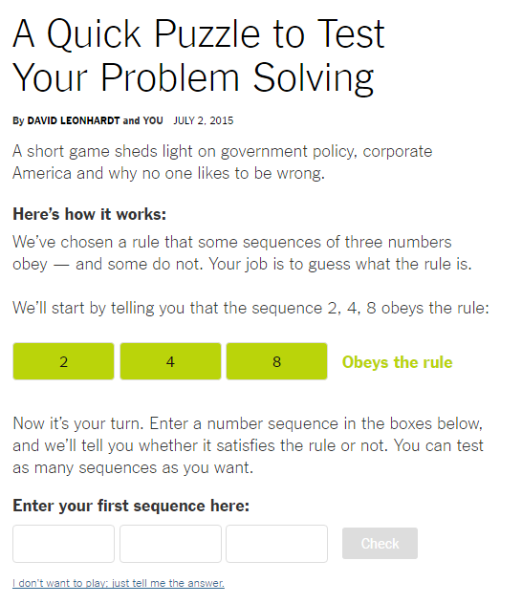
Notes:
http://www.nytimes.com/interactive/2015/07/03/upshot/a-quick-puzzle-to-test-your-problem-solving.html?_r=0

Slide 32
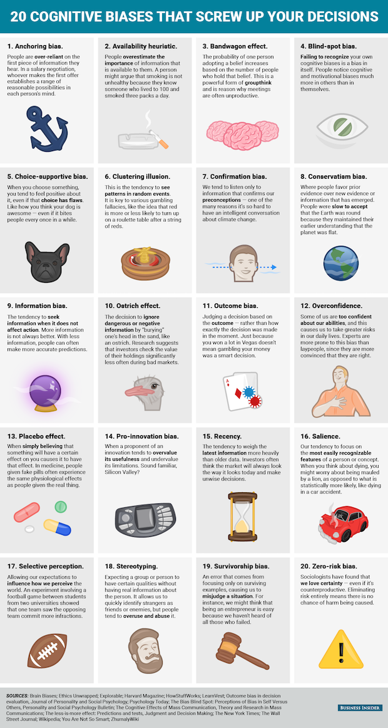
Notes:
It’s important to distinguish between cognitive biases and logical fallacies. A logical fallacy is an error in logical argumentation (e.g. ad hominem attacks, slippery slopes, circular arguments, appeal to force, etc.). A cognitive bias, on the other hand, is a genuine deficiency or limitation in our thinking — a flaw in judgment that arises from errors of memory, social attribution, and miscalculations (such as statistical errors or a false sense of probability).

Slide 33
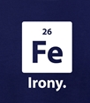

Slide 34
100,000,000,000,000,000
Notes:
Some social psychologists believe our cognitive biases help us process information more efficiently, especially in dangerous situations. Still, they lead us to make grave mistakes. We may be prone to such errors in judgment, but at least we can be aware of them. Here are some important ones to keep in mind.
And yet, this is the number of process our brain is capable of per second (10^16).

Slide 35


Slide 36
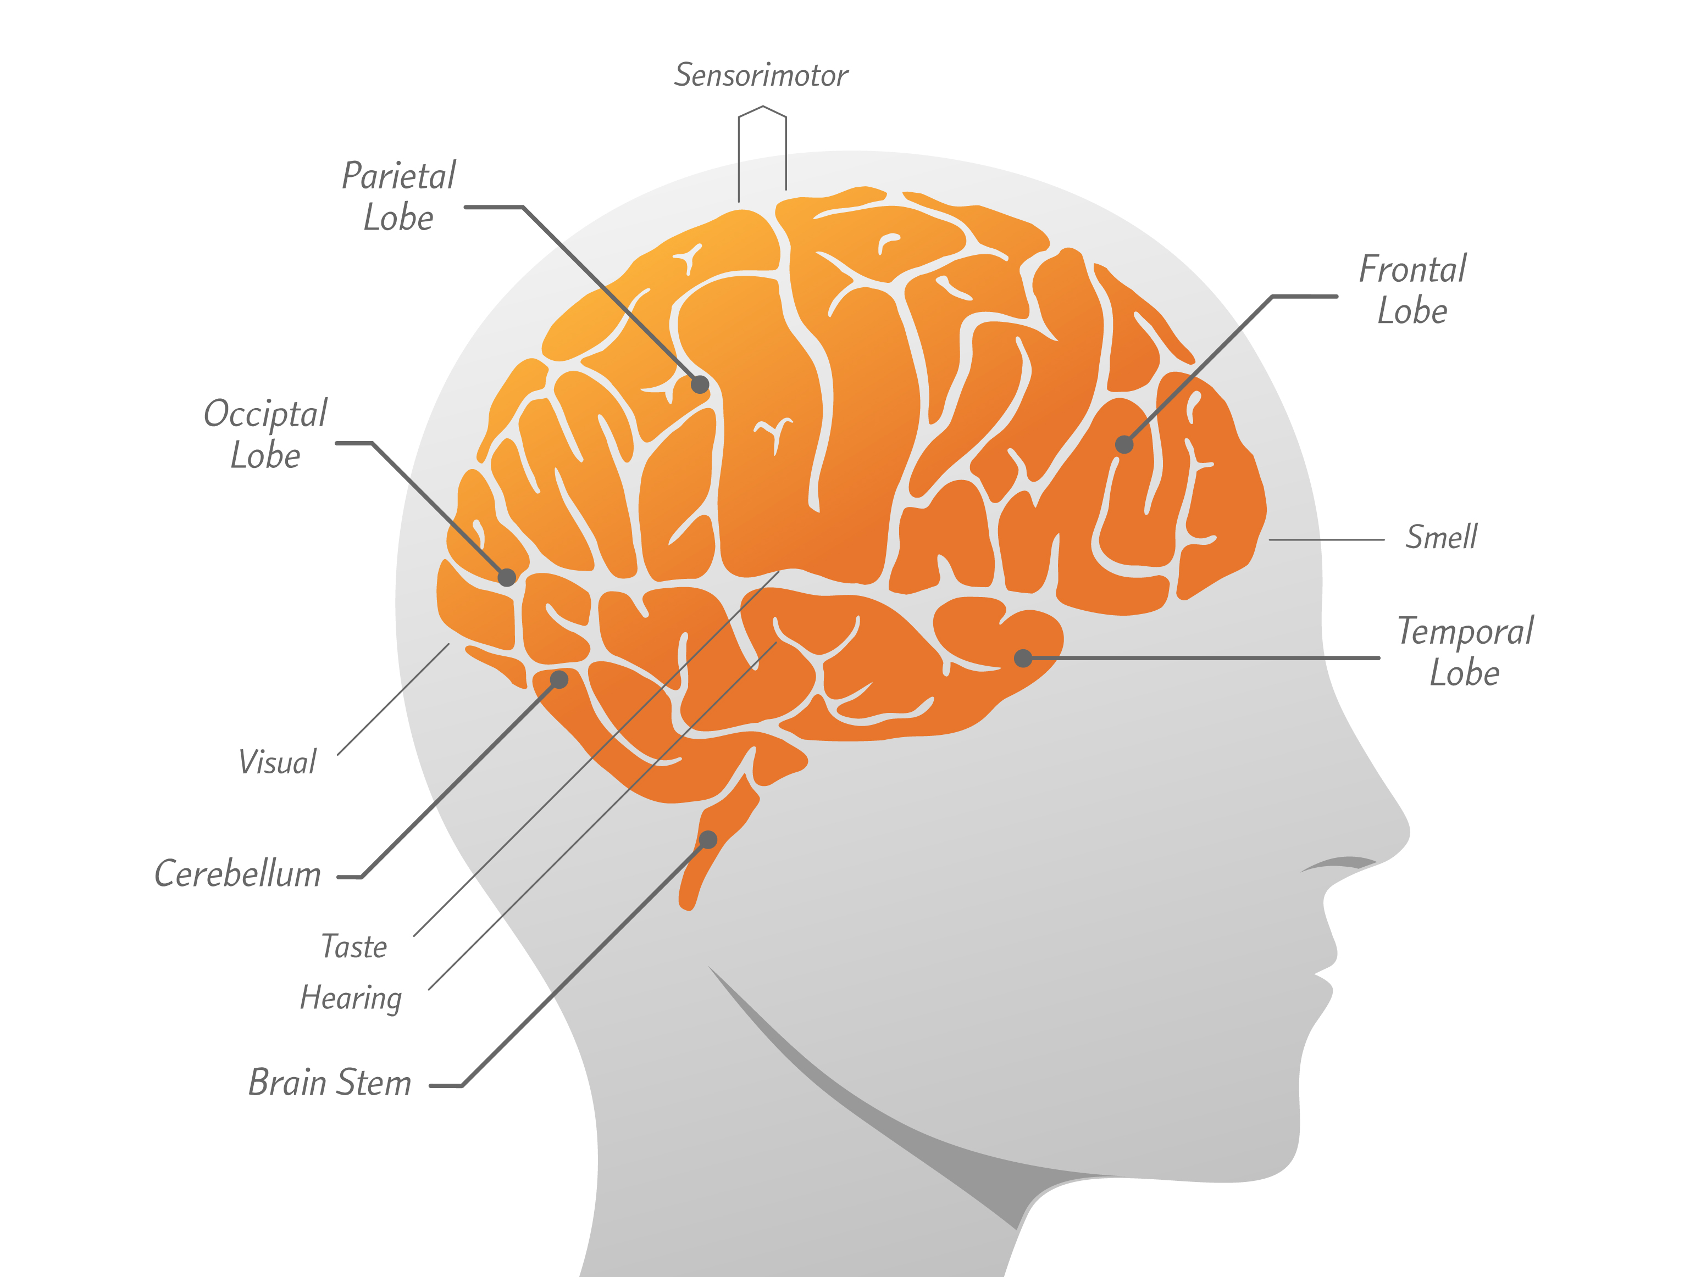
Notes:
Jacques Minard had an intuitive sense of how to communicate data visually. This intuition made him a pioneer of a new field of inquiry, one that would eventually become the Beautiful SCIENCE of Data Visualization.
I call it a SCIENCE because the field of data visualization is backed by or built on on the proven observations of cognitive and perceptual psychology. In other words, scientists have studied how our brains perceive and think, and that gives us concrete ways we can help people see and understand data.
So, how do we, as humans, actually do this? Let’s take a look at the brain.
We all have brains. and these are not some undifferentiated mass of goo. While our understanding of this organ is still primitive, we do know that there are many different parts of the brain. For example, the prefrontal cortex is an area critical to planning, personality, and decision making. Together, let’s go on a tour of the brain and explore some of its parts by using them a little.

Slide 37
Notes:
How many circles are there? Feel free to shout it out.
Why am I starting here? Well, there’s a part of your brain that just lit up, counting to nine. This is a very specific part of your brain, different from the part that knows “a lot” from “a little” It’s made just for counting.
Now that we’re all warmed up, let’s count some more.

Slide 38
Notes:
How many 9’s do you see here? It’s hard to count in this case, because it’s hard to scan all the numbers and find the ones you’re looking for. But, we can make it a lot easier…

Slide 39
Notes:
NOW count the nines. How many nines do you see? (TEN)
When we color the nines RED, we activate a different part of your brain, the visual cortex. Good at discerning color.
A wonderful thing about our brains is that there are lots of parts, working together – sorting by color and counting work together in tandem.
Of course, we can take advantage of this science in data viz, too. Let’s look at some numbers with more meaning.

Slide 40
Notes:
Each number here represents one country. Specifically, it’s the percent of their economy they spend on the military. For this example, I hope you’ll forgive my bias; I stuck to a part of the world I know a bit better than Asia.
For example, CLICK this 5 here means that the United States spends about 5 percent of its GDP on the military.
What if I want to know how common it is to spend 5% or more on the military? CLICK I could look for all the numbers 5 or bigger, or could just color those numbers and leverage visual pop-out.

Slide 41
Notes:
Now it is quick to see there are only three countries in Europe and the Americas that spend more than 1/20th of their GDP on military.
Again, my color perception and counting skills are brought into play.
If I take a step further and SORT these values…

Slide 42
Notes:
…we start to see GROUPS of similar values. We also build on our intuitive sense of relationship and proportion.

Slide 43
Notes:
When I add another region, the Middle East, again color perception helps us draw some conclusions before we even understand what we’re seeing. But now instead of precise counting, we draw on rough estimation of size and proportion that’s informed by color.
We layer this visual intuition on top of our cognitive understanding of the world and come to new conclusions.
We could also look at this information on a map…

Slide 44
Notes:
Now we’ve traded the positional information of sorting and used the position to communicate geography. We still get the fast visual grouping of the yellow countries all together, which is informed by the slower, cognitive process of understanding geography. By the way, if you’re wondering where the two yellow European countries went, they are still there, but they are both too small to show at this scale.
You may notice that we’re getting into a dialogue with the data. We see something, develop an understanding, and ask a new question. So, let’s ask another. These images are all about percent, but what about absolute spending on the military?

Slide 45
Notes:
We can add total spending as a new kind of visual cue: size. …and a new understanding of the data comes to light. Now we can see which countries not just spend the most of their money, but also which ones spend the most overall.

Slide 46
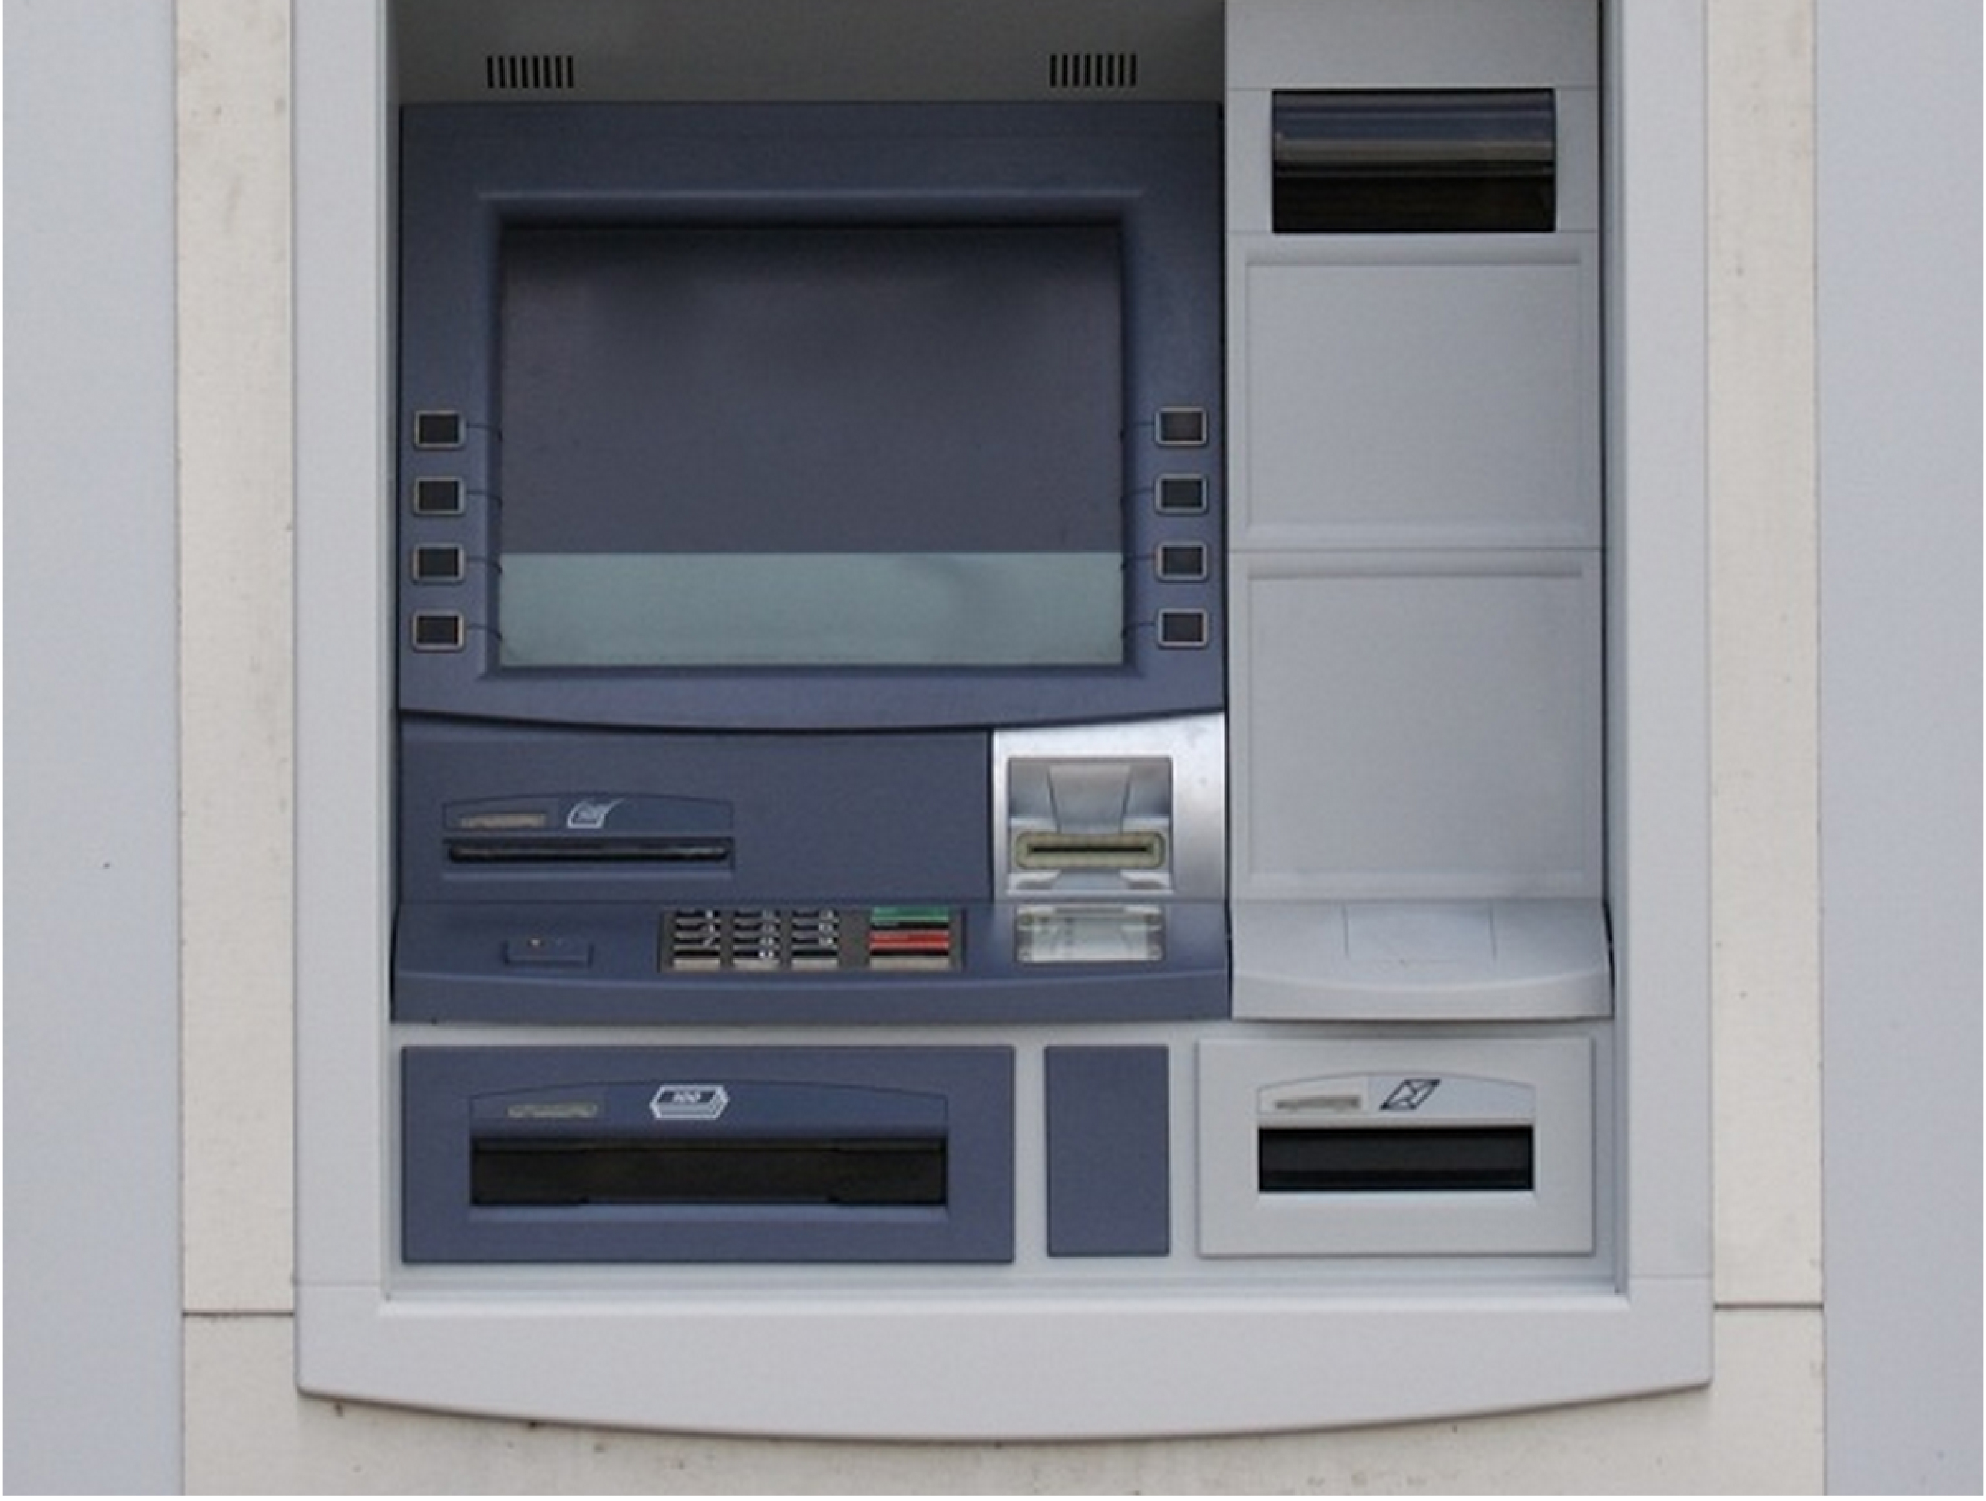
Notes:
This is a relatively modern ATM, with a color screen instead of a two-line LED readout like some original models. When ATMs came out, my mother worked for a bank. The bank itself was unremarkable except for one thing: they had the vision to foresee that ATMs would become popular. It was not a given that people would trust machines to accurately replace human tellers. But this little bank--Connecticut Bank & Trust—believed in the power and convenience of ATMs, and they saw it as their mission to build trust in these new machines. So they literally put a friendly face on them.

Slide 47
Barney
Notes:
Meet Barney. This name and this face were the brand of these ATMs. The designers of this logo knew how to create meaning for human beings. Three circles, two curves, two triangles, and a line and we see a face. And not just a face, but one that suggests trust.
GO FORWARD

Slide 48
Notes:
The Barney brand was incredibly successful. It was so recognizable in the region that any bank's ATM came to be known as a "Barney machine.” … When polled about Barney, (SMILE!) can you guess what feature people liked the most about him? His SMILE. This is remarkable to me for at least two reasons. First, HE’S NOT A PERSON… The logo is just a collection of simple shapes and lines. Second (BACK FROM WHITE) …

Slide 49
Barney
Notes:
He doesn’t have a smile.
So what’s going on here? Our memories are stored as the patterns we understand. When we store a pattern like “face I trust”, it can get attached to things like “smile”.

Slide 50
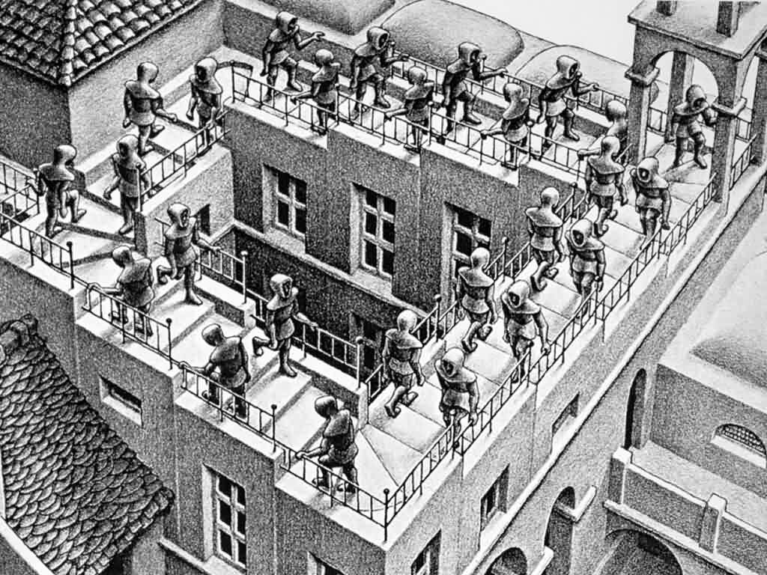
Notes:
It’s kind of like this drawing. In our minds, we don’t have a clean separation between stairs and walking, or up and down, or trustworthy and smiling. They are related ideas, and they come to mind together. This is one of the strengths of our intellect, our ability to form and use patterns. However, these patterns also sometimes lead to errors in judgment, like remembering Barney’s smile that’s not there. We call these cognitive biases.
I’ll give you another example. Primacy and recency are two other kinds of biases. When we see a list of unrelated items, we tend to remember the first item and the last more than the rest. The entertainment industry knows this. When you watch credits for a TV show, you will see the first listed name is the biggest star, and the special guest stars are last—they know that we remember the first and final names best. Because we are constantly making judgments and processing information, we are constantly at risk for cognitive bias.
So what does this have to do with visual analysis? Our visual system is enormously influential in our brains. Data presented clearly…

Slide 51
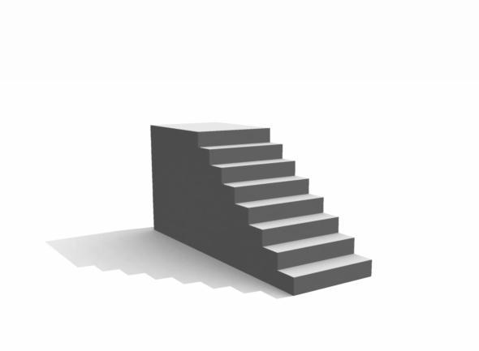
Notes:
…reduces cognitive bias.
And THIS is where the beautiful science of data viz comes in. Data viz takes advantage of how we perceive; it uses the power of perception in our brains to strip away the false patterns by focusing on what’s right in front of us… We hack our brains to work for us instead of against us.
So how do we hack the brain? Science has started to teach us the specific ways we can draw shapes to create meaning VISUALLY.

Slide 52
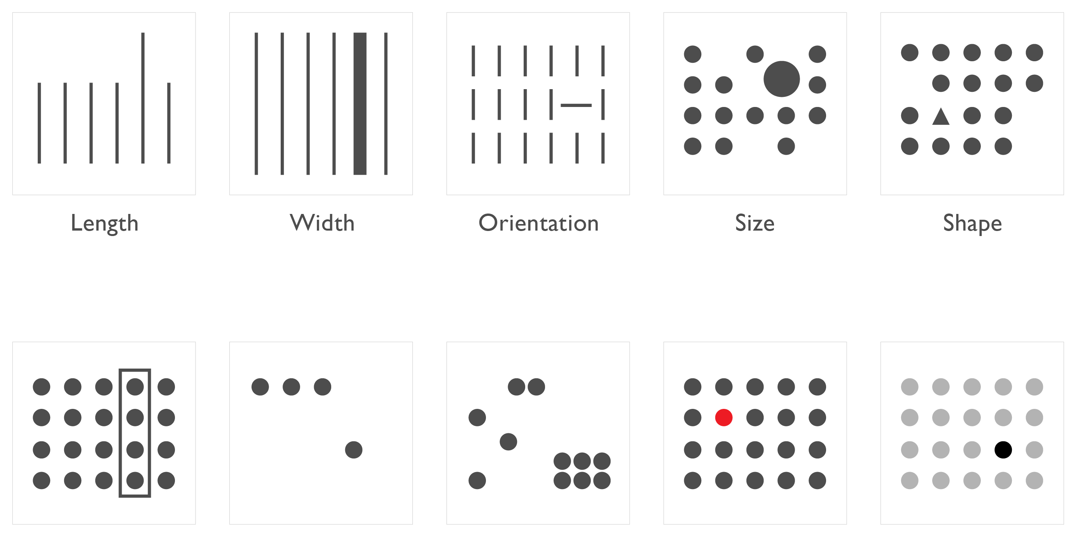
Length | Width | Orientation | Size | Shape
Enclosure | 2D Position | Grouping | Color (Hue) | Color (Intensity)
Notes:
Here are some of these ways to draw.
Well, we have already seen some of them at play, like color hue and size, but as you can see, there are many more. These VISUAL FEATURES activate the powerful visual system in an incredibly fast way, usually before we can even begin to think about it.
To help explain how fast this perception happens, I’d like to show you a video.
Healey video – preattentive features: https://www.youtube.com/watch?v=wnvoZxe95bo

Slide 53
Types of data
CATEGORICAL
ORDINAL
QUANTITATIVE
Asia
Europe
North America
Alice
Robert
Chris
Water
Coffee
Tea
Gold
Silver
Bronze
Solid
Liquid
Gas
January
February
March
Weight
10 kg, 35 kg, 100 kg
Cost
$500, $2.5 million, $4 billion
Discount
0%, 2.5%, 5%
Date
14 March 2015 14:02
Notes:
Categorical: How we break the world down into groups. The groups can be as large as continents or as small as individuals.
Ordinal: This are simply categories that can be put into a meaningful order. Dates are sometimes ordinal, too.
Quantitative: These are the measurements of the world around us. They are values that can be placed on an axis, or things that we can find the difference or distance between.
So, what are the best visual ways to communicate these different data types?

Slide 54
Visual features for data
CATEGORICAL
ORDINAL
QUANTITATIVE
Position
Color hues
Shape
Clusters
Boundaries
Position
Size
Color intensity
Color hues
Shapes
Position
Length
Size
Color intensity
Up to 2 Color hues
Orientation (Change)
Notes:
(Narrate the columns. No great ideas for making this fascinating.)
Notice that regardless of the data, one of the best ways of explaining it is through its position.
Let’s look at some other time-tested examples of data visualization and see how modern perceptual science explains why they work so well.

Slide 55
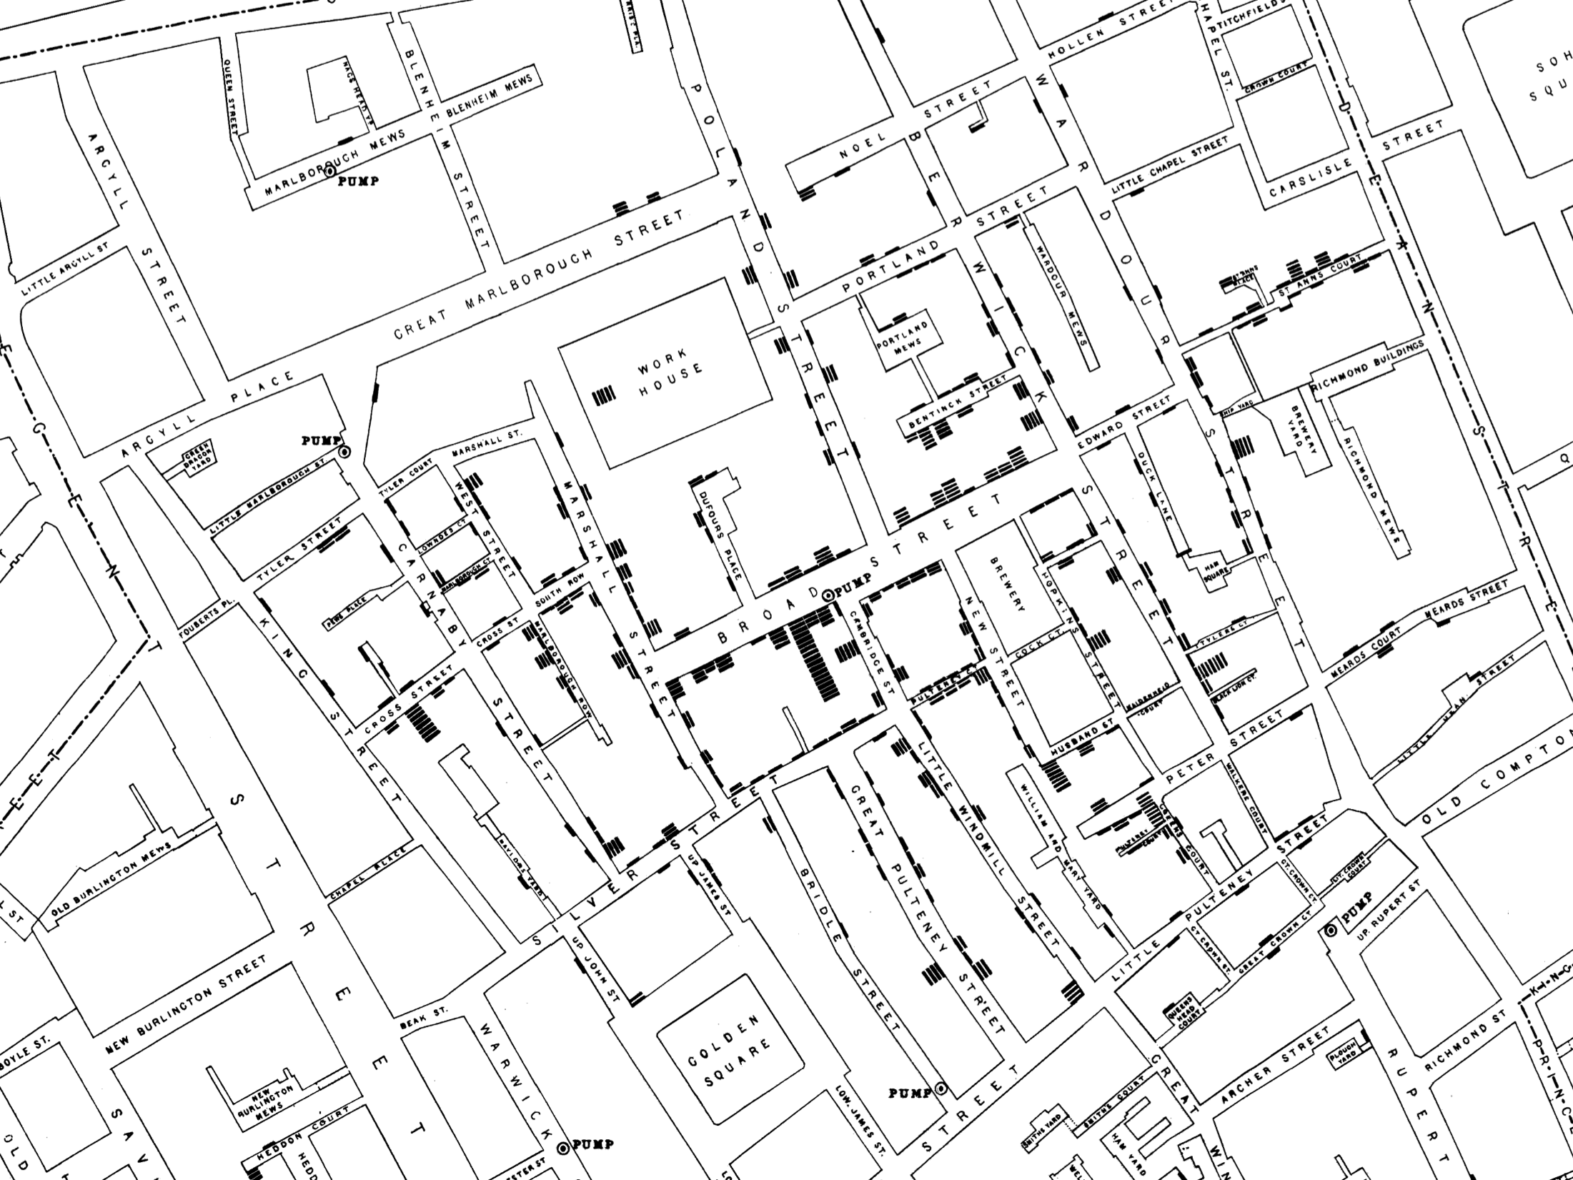
Notes:
In the 1800s, a London doctor named John Snow used this map to show how cholera was being transmitted by contaminated water from a pump CLICK here on Broad Street. The black marks like these here CLICK show the number of infections at an address. CLICK Like all maps, this uses the visual feature of position to illustrate geography and its correlation to the disease. The length of the black marks maps to the quantitative value of the number of patients. Clustering shows us how the outbreak was centered around the contaminated well.
background info:
map was made after the fact
miasma theory was prevalent before Snow made his case
pump handle was removed
tragedy after the fact was that they put the handle back on after the panic over the deaths was done

Slide 56
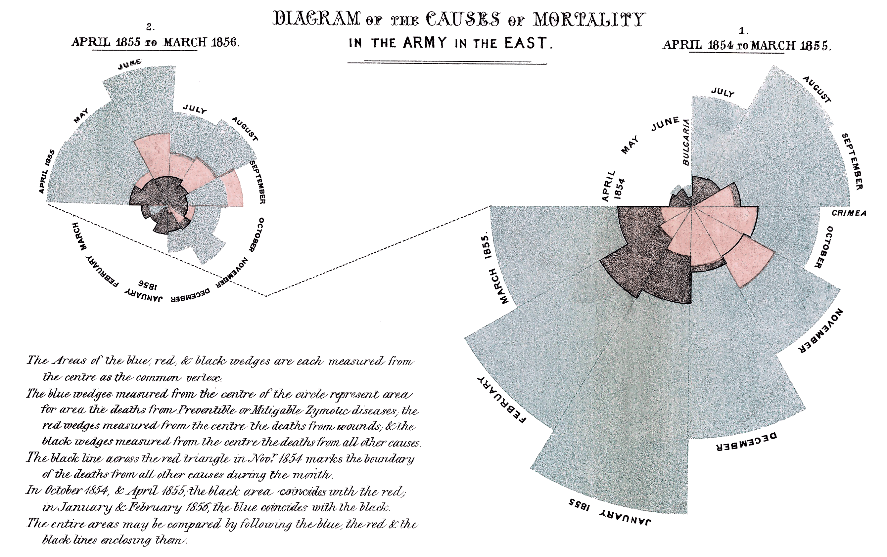
Notes:
This is another chart from England in the1800s; this one was made by Florence Nightingale. Again, showing a story about death—I promise, the rest of the talk is much more upbeat. She wanted to explain to Parliament and government officials how battle wounds—shown in red—were taking nowhere near as many lives as treatable conditions, which are the bluish gray. She uses position around the circle for the ordinal value of months, the size to represent the quantity of deaths, and color hue as the category of cause of death.
background info:
She made extensive use of coxcombs to present reports on the nature and magnitude of the conditions of medical care in the Crimean War to Members of Parliament and civil servants who would have been unlikely to read or understand traditional statistical reports. In 1859, Nightingale was elected the first female member of the Royal Statistical Society. She later became an honorary member of the American Statistical Association.

Slide 57
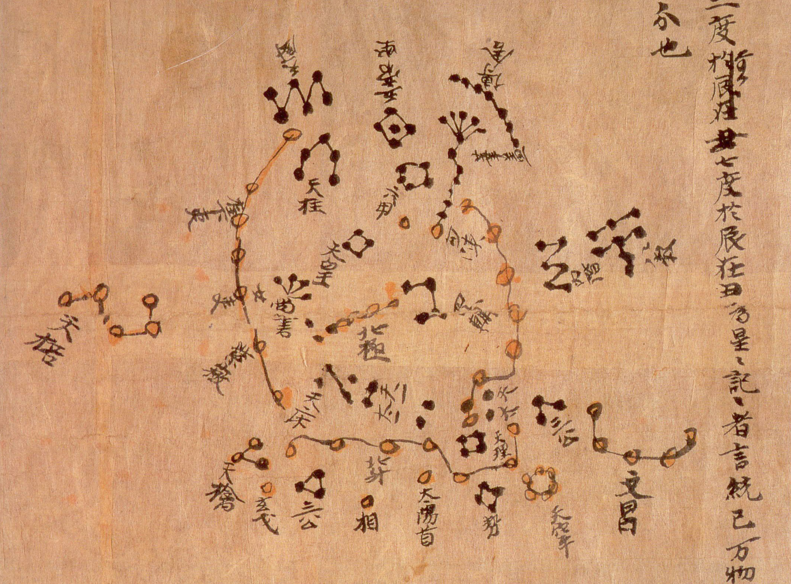
Notes:
One last example, from 1300 years ago. These star charts are from the world's oldest complete preserved star atlas. Back before Europe was even a thing, Chinese astronomers used position to document locations of the stars, clustering of shapes and lines to represent constellations, and color hues to represent the categories of three different schools.
For over a thousand years, we have been using our intuition to describe what we’re seeing around us. Some of our most powerful successes have relied on perceptual psychology that we have have only understood in the last few decades. So, let’s bring together our ancient fascination with another recent scientific advance.
background info:
"Dunhuang star map". Licensed under Public Domain via Wikimedia Commons - https://commons.wikimedia.org/wiki/File:Dunhuang_star_map.jpg#/media/File:Dunhuang_star_map.jpg
This map was made around the year 700. Constellations of the three schools were distinguished with different colors: white, black and yellow for stars of Wu Xian, Gan De and Shi Shen respectively. The map provides a graphical verification of the star observations, and are part of a series of pictures on one of the Dunhuang manuscripts. The astronomy behind the map is explained in an educational resource posted on the website of the International Dunhuang Project, where much of the research on the map has been done. The Dunhuang Star map is to date the world's oldest complete preserved star atlas.

Slide 58


Notes:
Let’s talk about how we decide where to look for life in space….?
6 years ago, the Kepler Space Telescope was launched. (Telescope… IN SPACE!) By getting a telescope up out of the atmosphere, you get a much clearer image. So clear, in fact, that you can watch a distant star, see the color or intensity change slightly every so often, and figure out that it’s a planet changing the light that reaches Kepler. Earlier this year, astronomers announced Kepler has spotted 8 planets that might be hospitable to human life.
This data set has one row for each planet we think we have seen circling another star.

Slide 59
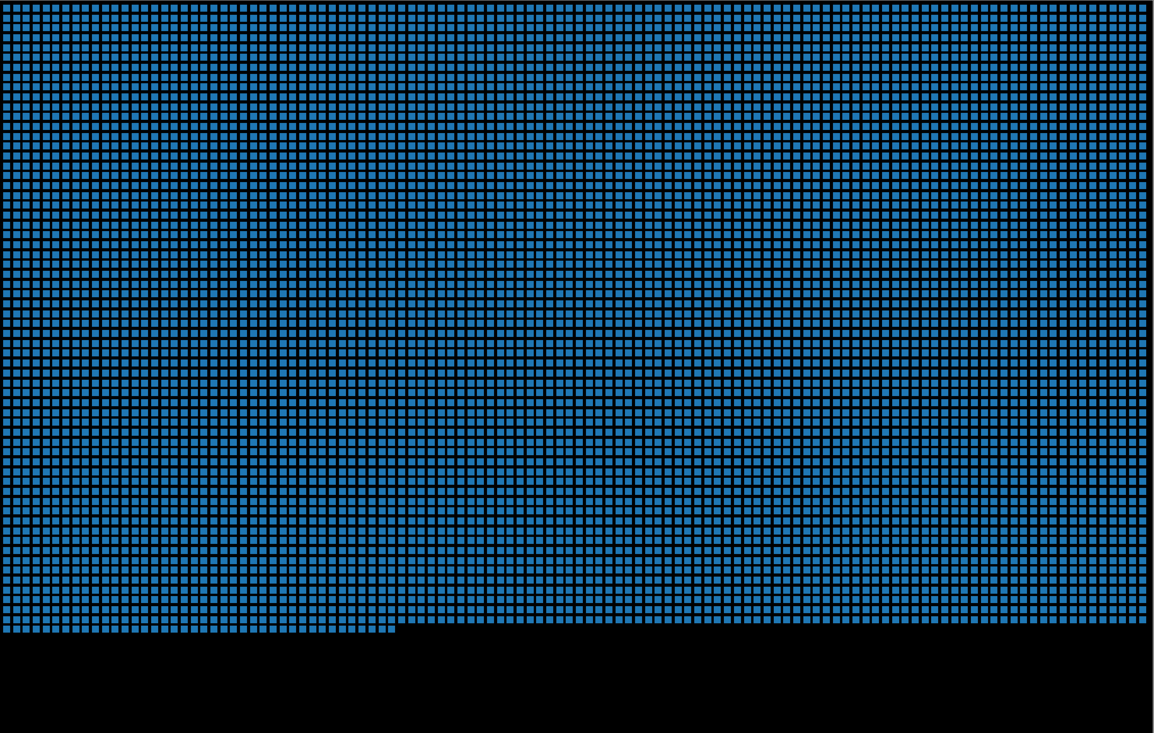
Notes:
DEMO backup slides
Visual system gives you a sense of order of magnitude quickly – not tens, not millions, but hundreds or thousands of candidate planets

Slide 60
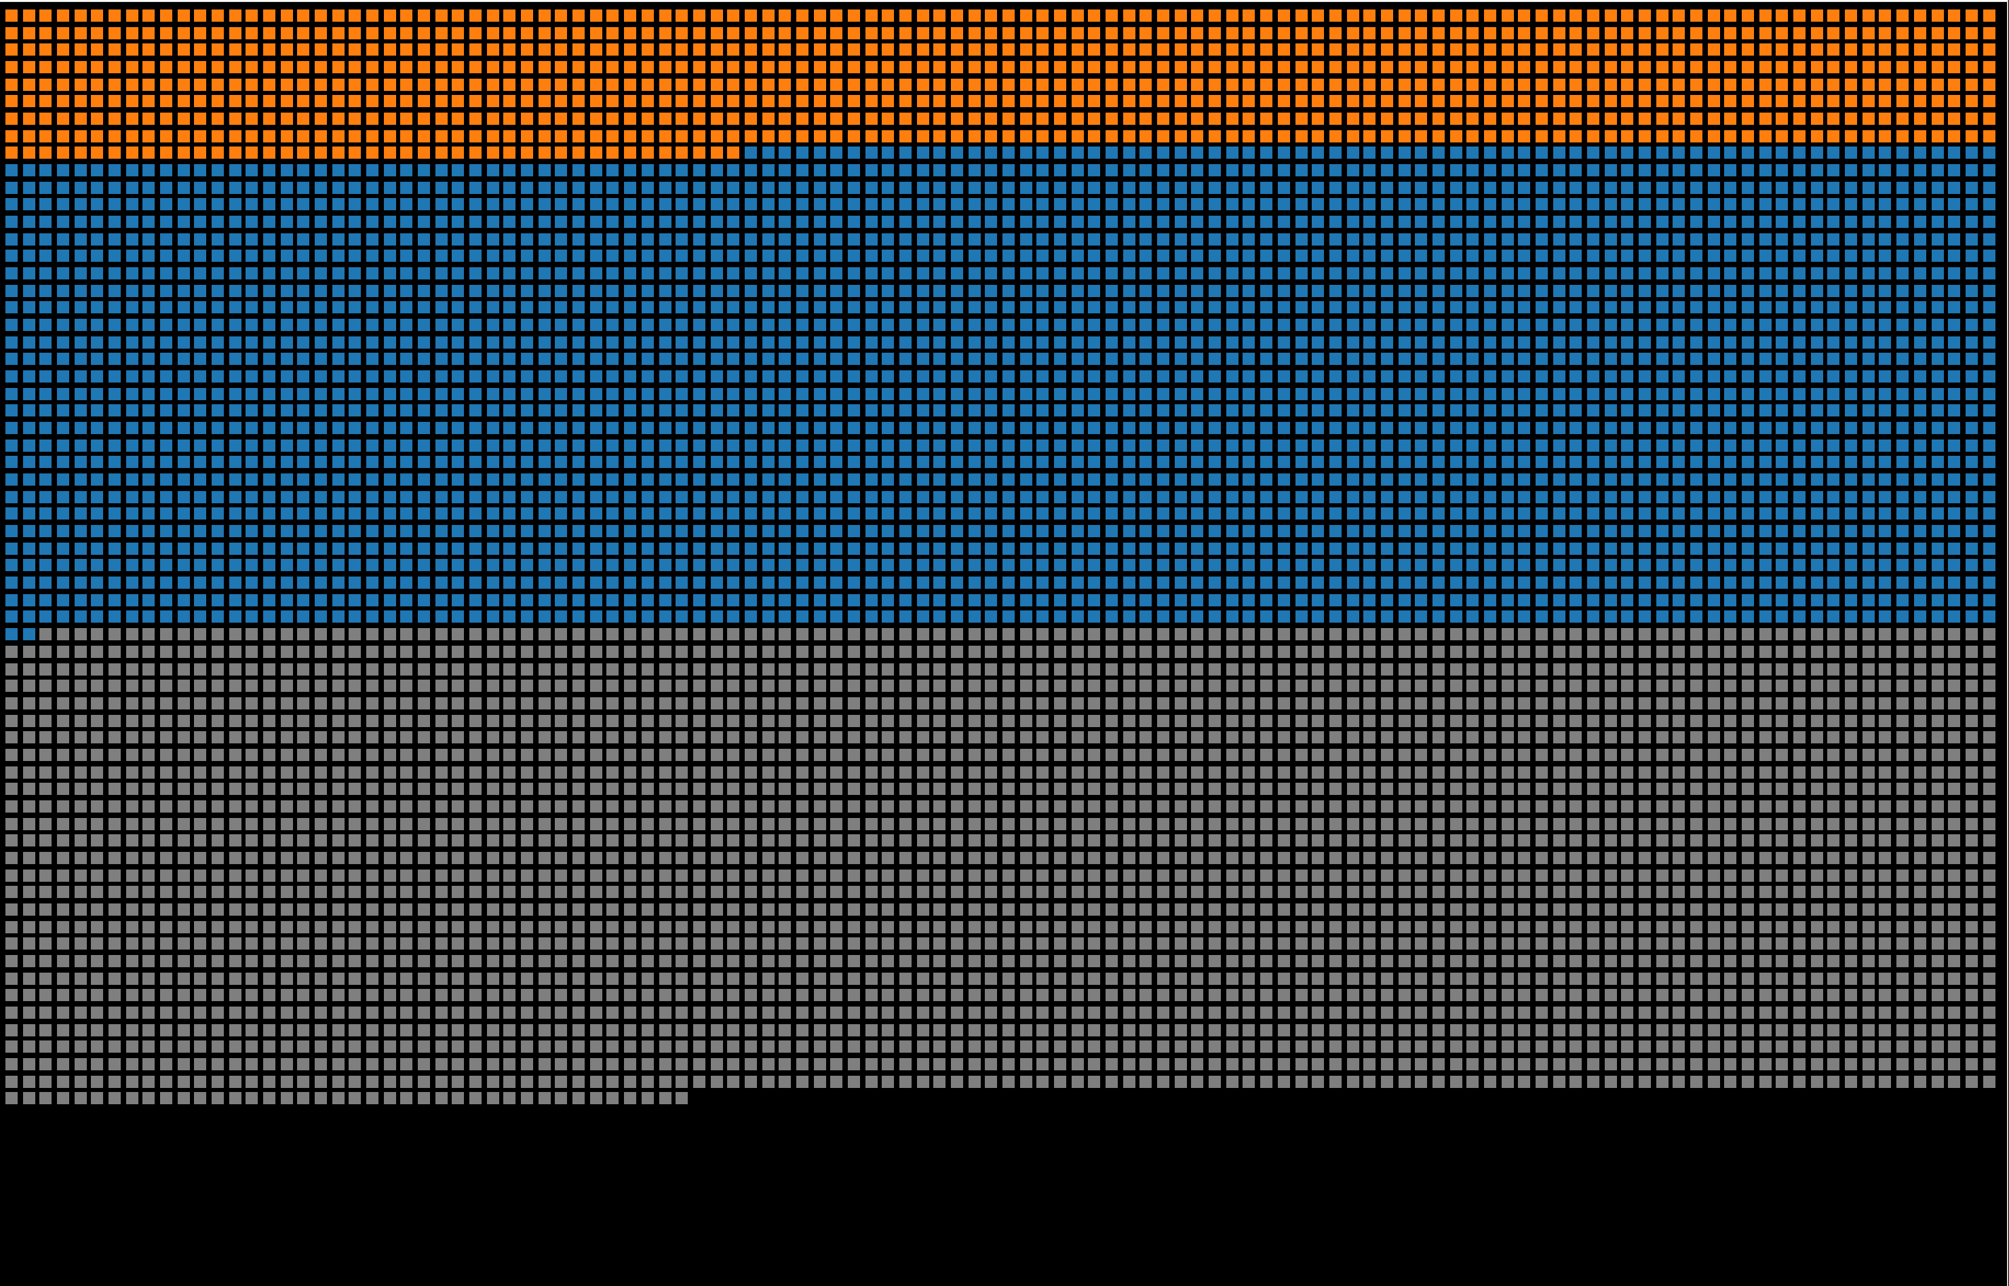
Notes:
Clustering, color, color boundaries give pre-attentive sense of proportion

Slide 61
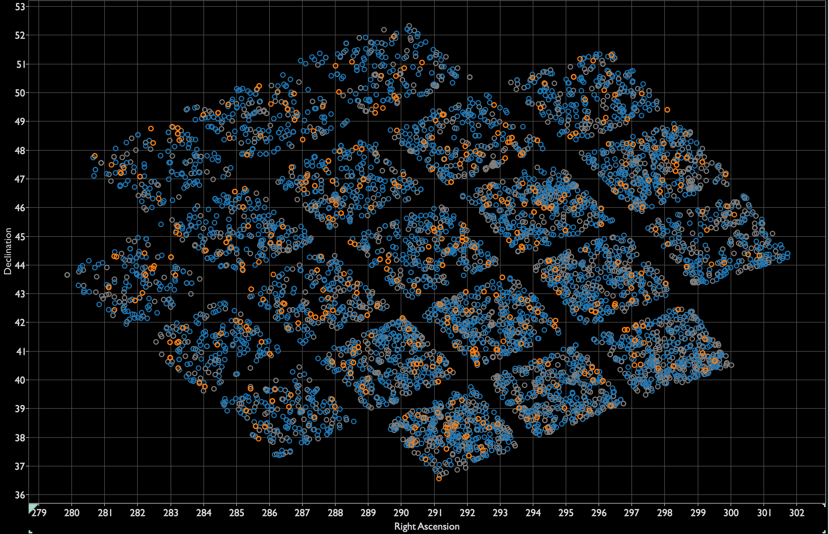
Notes:
Position reveals more clustering… why are the planets arranged like this?

Slide 62
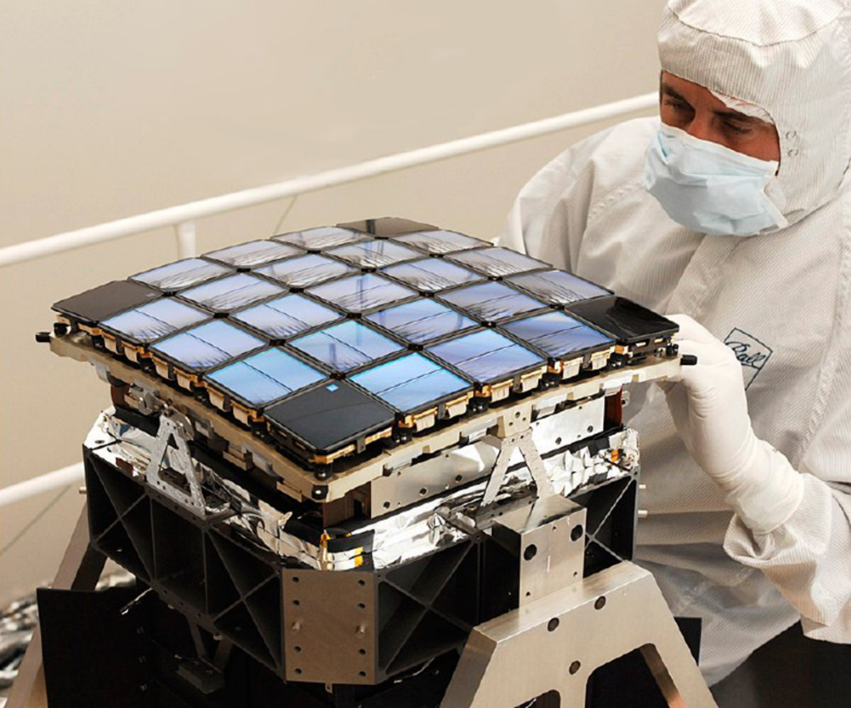
Notes:
This is what the camera inside Kepler looks like

Slide 63
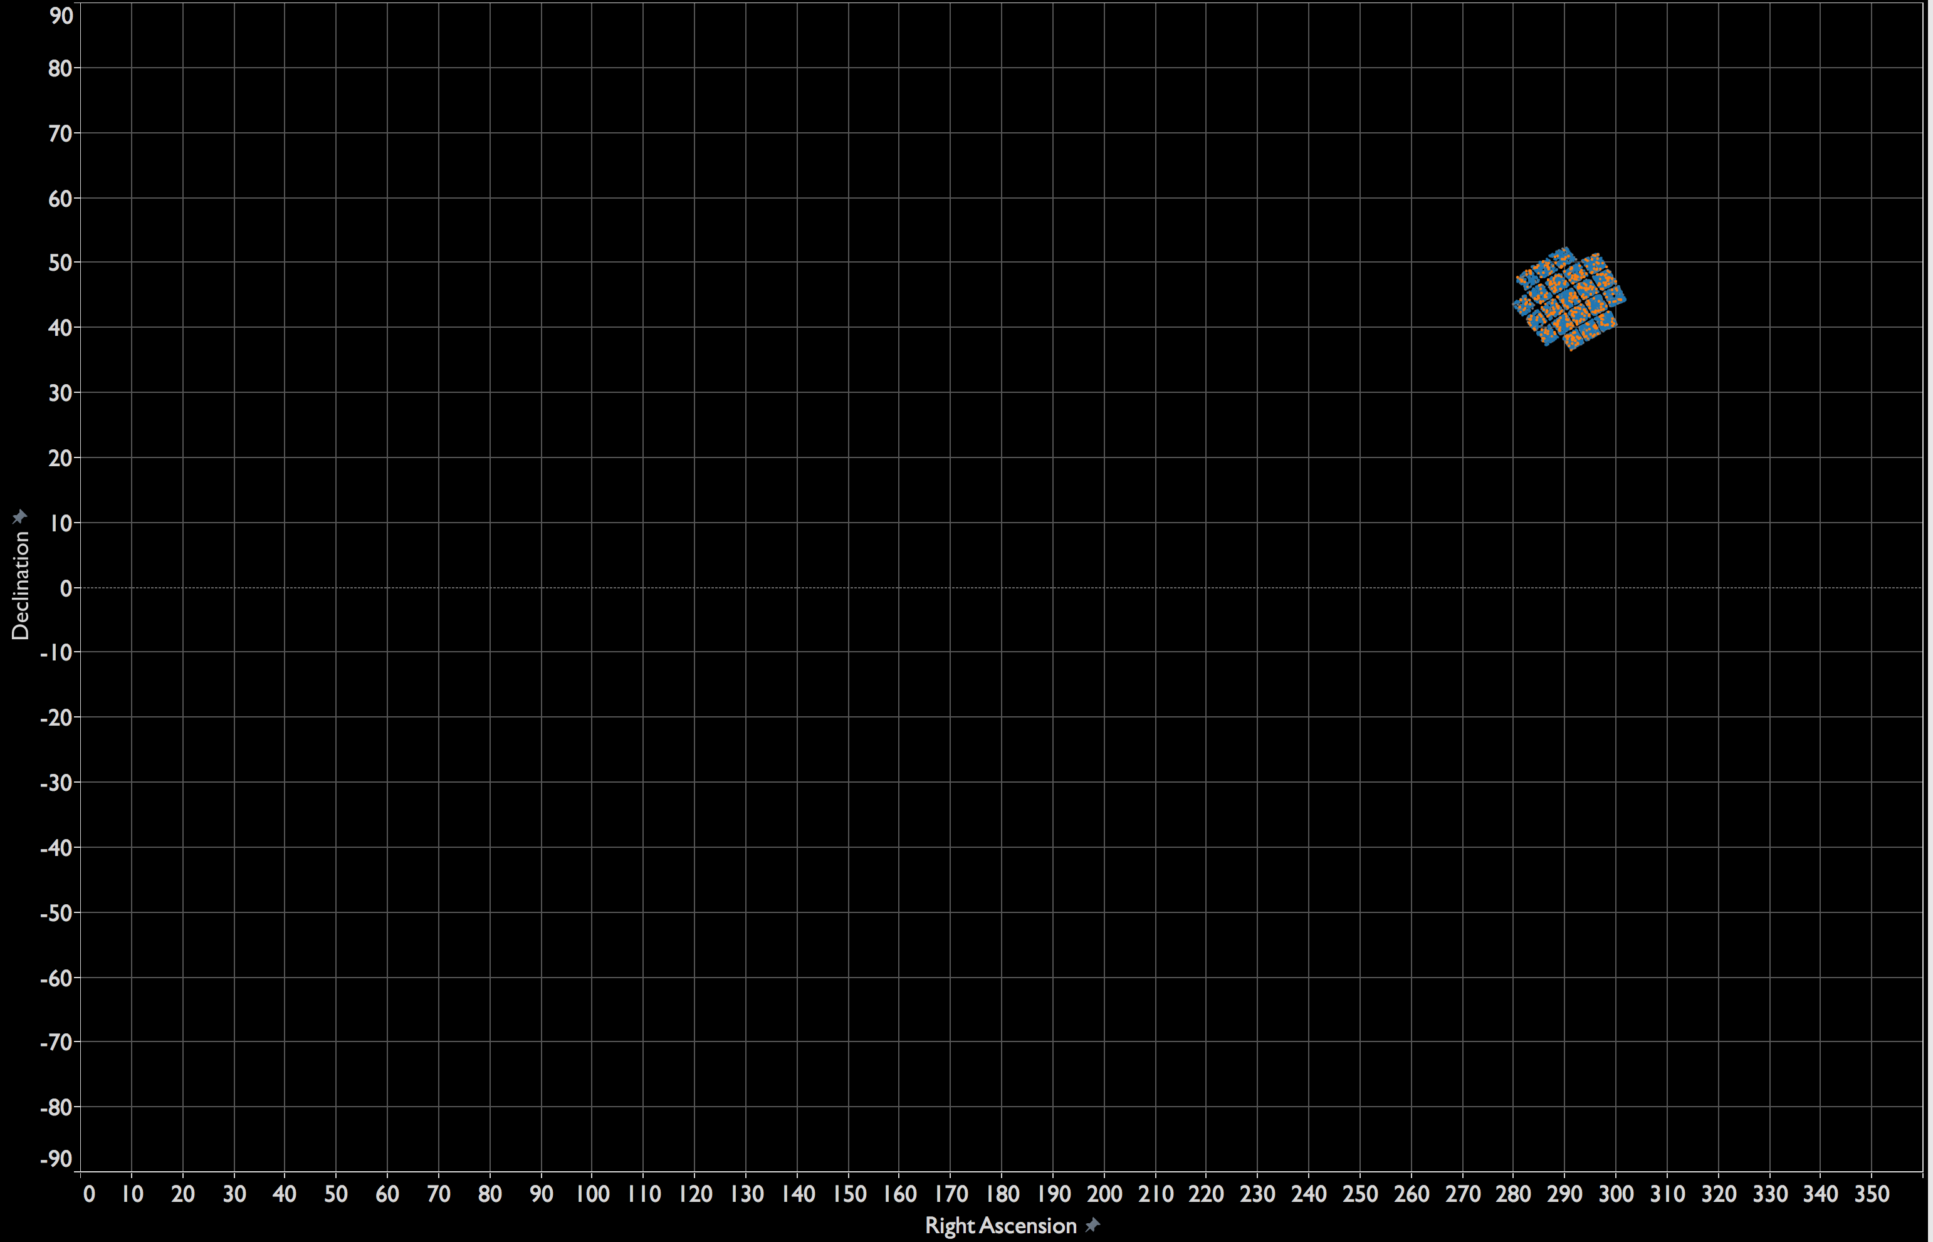
Notes:
Thousands of candidates, 8 goldilocks, but this is the only part of the sky we have looked at with Kepler.

Slide 64
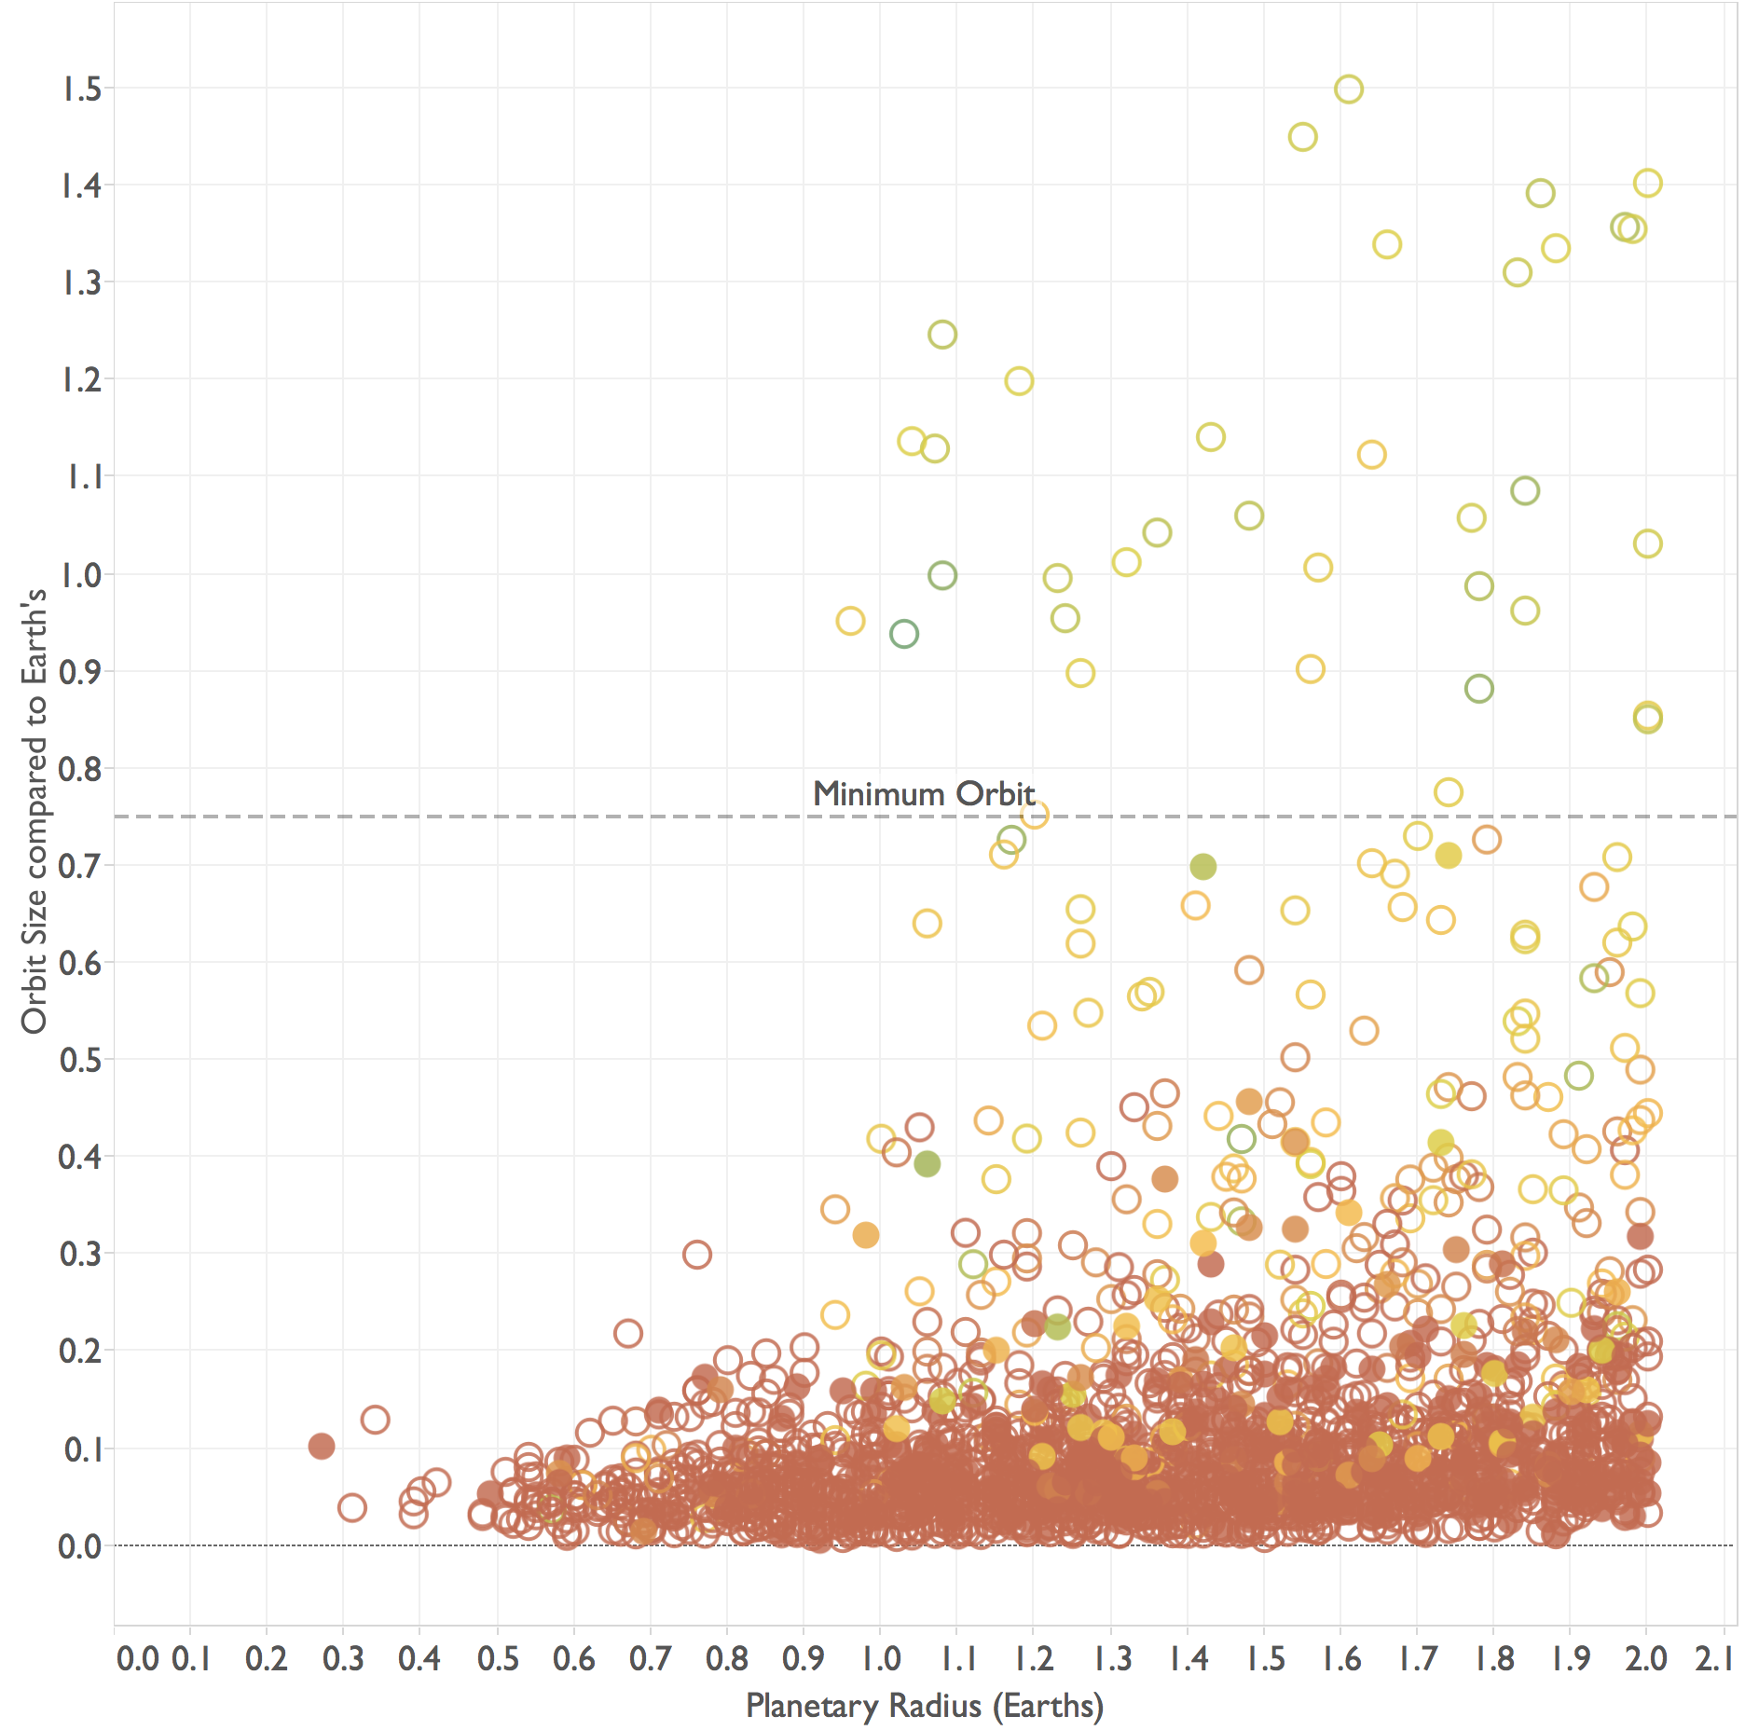
Notes:
Goldilocks scatter.
Let’s pause and reflect on what just happened. We used color hue, color intensity, clustering, boundary detection, position, shape, and size to understand data from a telescope (in SPACE). We went back and forth between making intuitive, visual sense and cognitive processing. One informed the other.
What makes this science so COOL to me is that data visualization opens the funnel for how much information that humanity can actually USE. As a species, we have more information available than ever, and we—you and I—are bringing the world the technology that lets us access that information meaningfully and purposefully.
Of course, this is not a one-time activity. Data is constantly coming into being, changing, growing. Our interests and needs are changing and growing.
Candidates above the Minimum Orbit line might be in the Goldilocks zone.

Slide 65
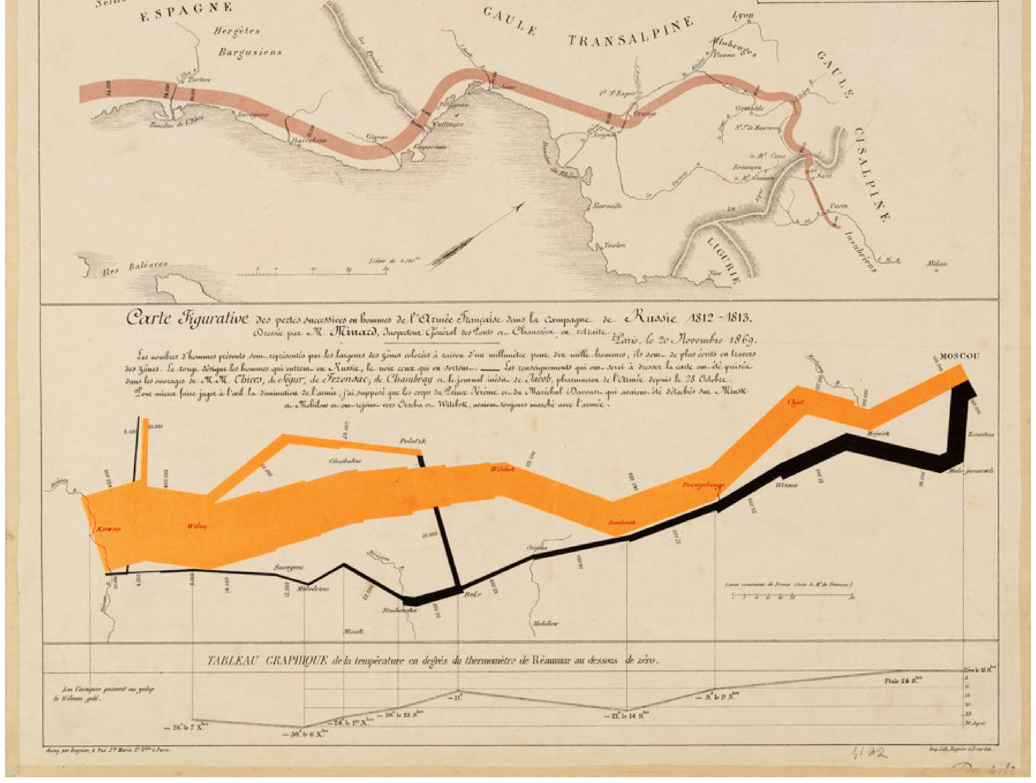
Notes:
In 1869, Charles Minard created this data visualization; it’s now one of the most famous examples cited by viz experts. On one sheet, it explains the beginning of the end for the French Empire and it’s leader, Napoleon. Let me add a little context.

Slide 66
1801
Notes:
In 1801, France looked about like this, which is what it looks like today. In 1804, Napoleon Bonaparte became the Emperor of the French and started a decade-long campaign of expansion. By 1812, thanks to an aggressive military campaign, the French Empire looked like this.

Slide 67
1812
Notes:
Here, at the height of his power, Napoleon wanted to score a decisive victory over Russia by taking his army to Moscow (CLICK). This turned out to be a profound mistake, and the reason why France looks like this today.

Slide 68
2015
Notes:
Let’s go back to the viz.

Slide 69
Notes:
In June 1812, Napoleon assembled his massive army in Poland and headed east toward Moscow, as shown by the thick, orange line. Over the next several months, brutal and efficient Russian tactics deprived the French a supply line, and the French numbers steadily dwindled. These losses are reflected in the orange line: it gets thinner and thinner as they march from left to right, west to east. When the French finally reached Moscow, over at the right edge of the drawing, Napoleon found no army there to fight. The Russians had abandoned and burned their own capital. Napoleon had no one he could force to surrender, and he still did not find the decisive win he needed.
By now, it was September, and the harsh Russian winter set in. Napoleon was forced to turn back. But the return trip—the heavy black line from Moscow back to Poland—was doubly cursed. In addition to ongoing Russian attacks, there was the deadly cold, the temperature line graph along the bottom reads from right to left, mapping temperatures to location. We can see the temperature reaches a low of -37 degrees Celsius in Маладзечна (Maladzechna). The black line shows the staggering loss of life, grows thinner from east to west. Nearly all the French soldiers were killed, and Napoleon did not deliver any major victory. This effectively ended a campaign of expansion and started the decline of the French empire.
This entire story is captured in this early masterwork in data viz. Minard skillfully combined position, color, line width, and thoughtful labels In one view to tell a story of troop strength; distance; temperature; location and direction of travel; and date—and ultimately a story of hubris.

Slide 70
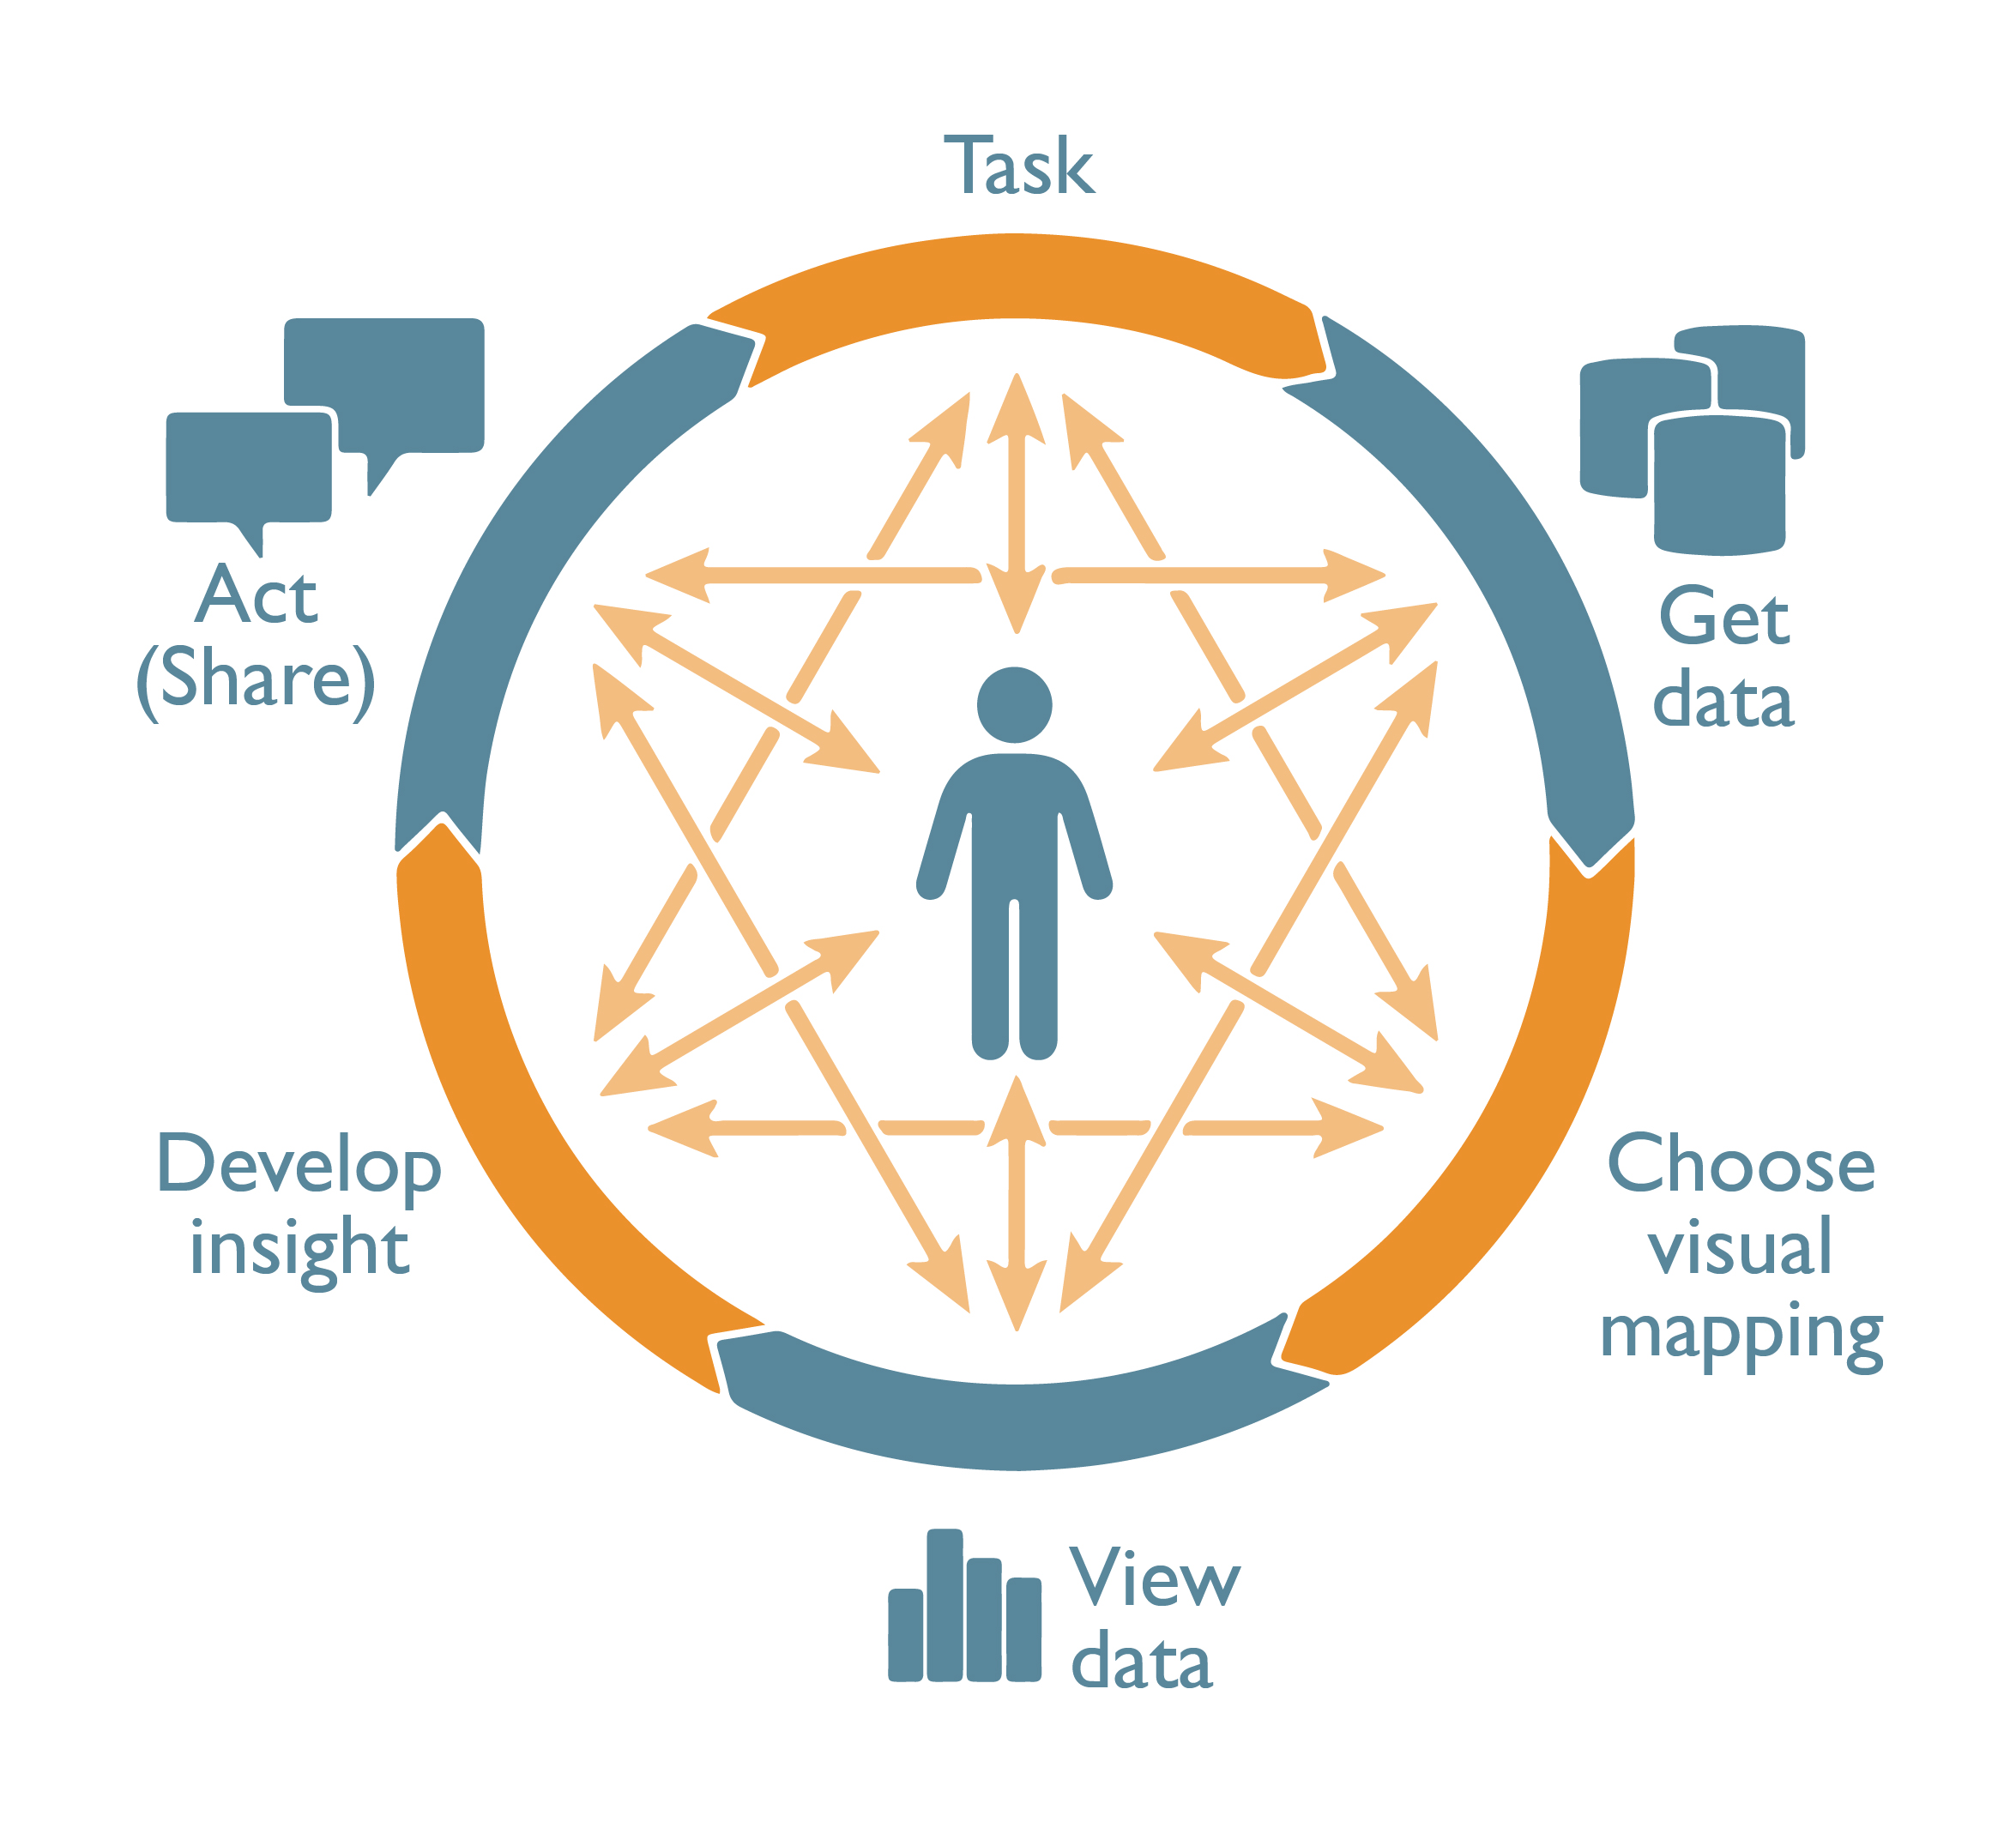
Notes:
At Tableau, we call the process of seeing and understanding data the Cycle of Visual Analysis, and we like to draw it like this. It is NOT linear, but jumps around. This cycle is more like a CONVERSATION than a flow of data through a process pipeline. It follows twists and turns as our understanding of the data grows. It’s important that our tools stay OUT of the WAY of this conversation, so it can proceed between people and their data.

Slide 71
Incremental
Notes:
INCREMENTAL (Principle #1)
The first is that conversations are incremental. When we talk to each other, each sentence and idea builds on what came before it. Tableau drag and drop interface supports this kind of INCREMENTAL conversation. As I ask one question, I get an answer. The answer to my next question is often just a drag or two away.

Slide 72
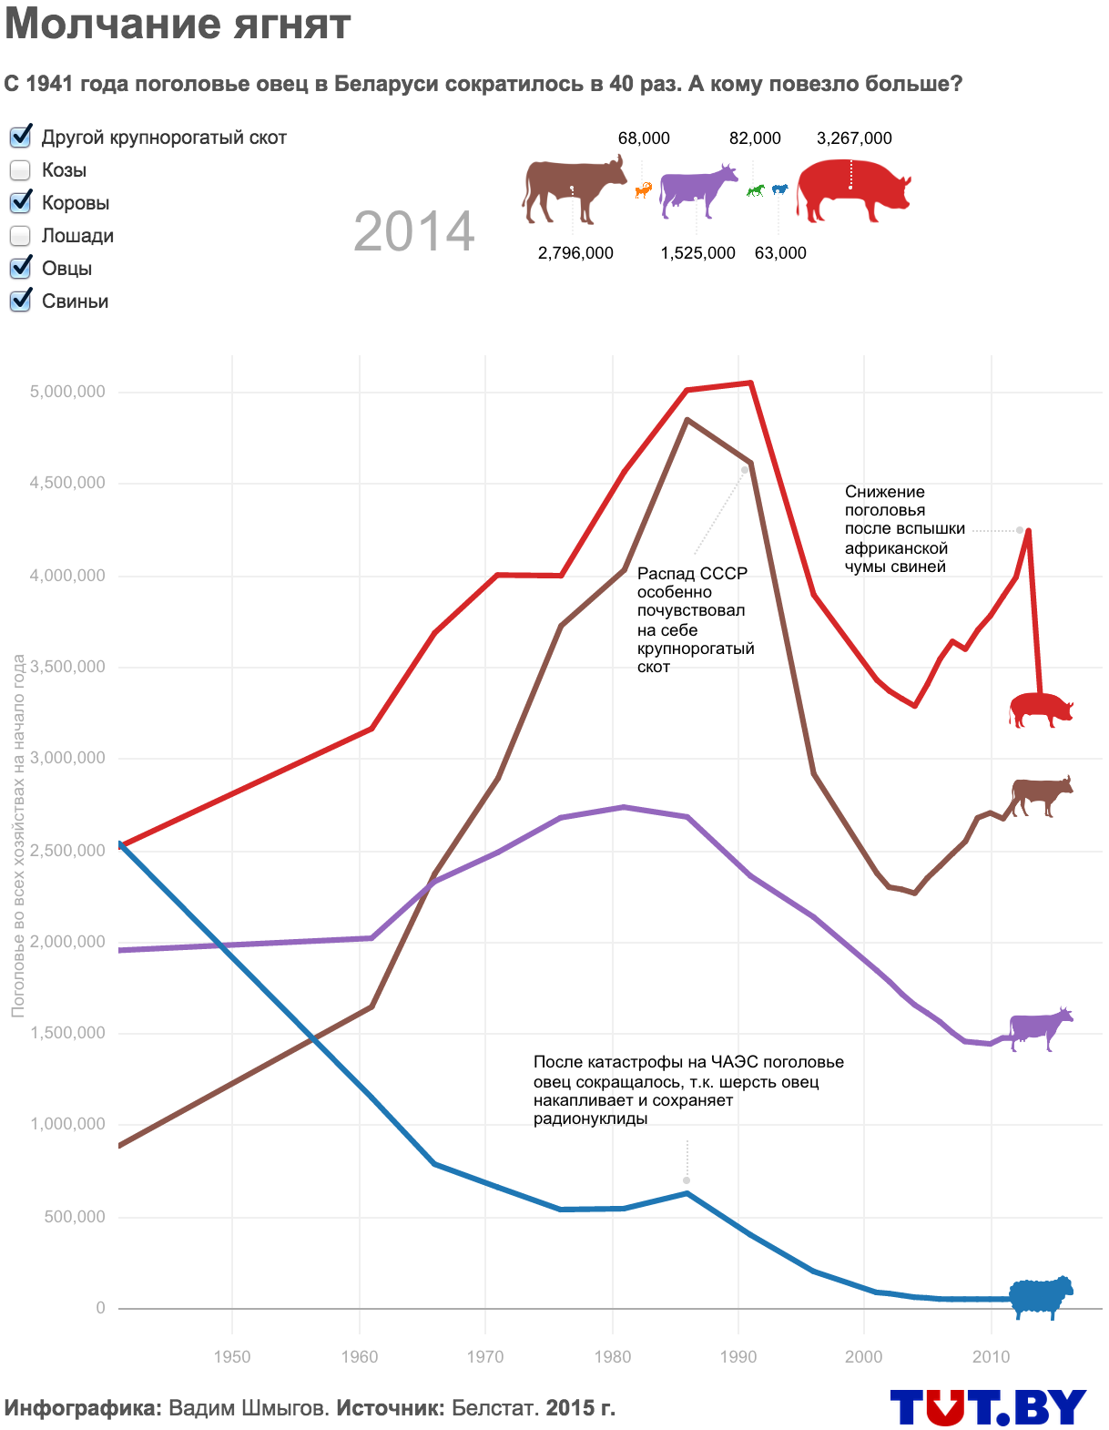
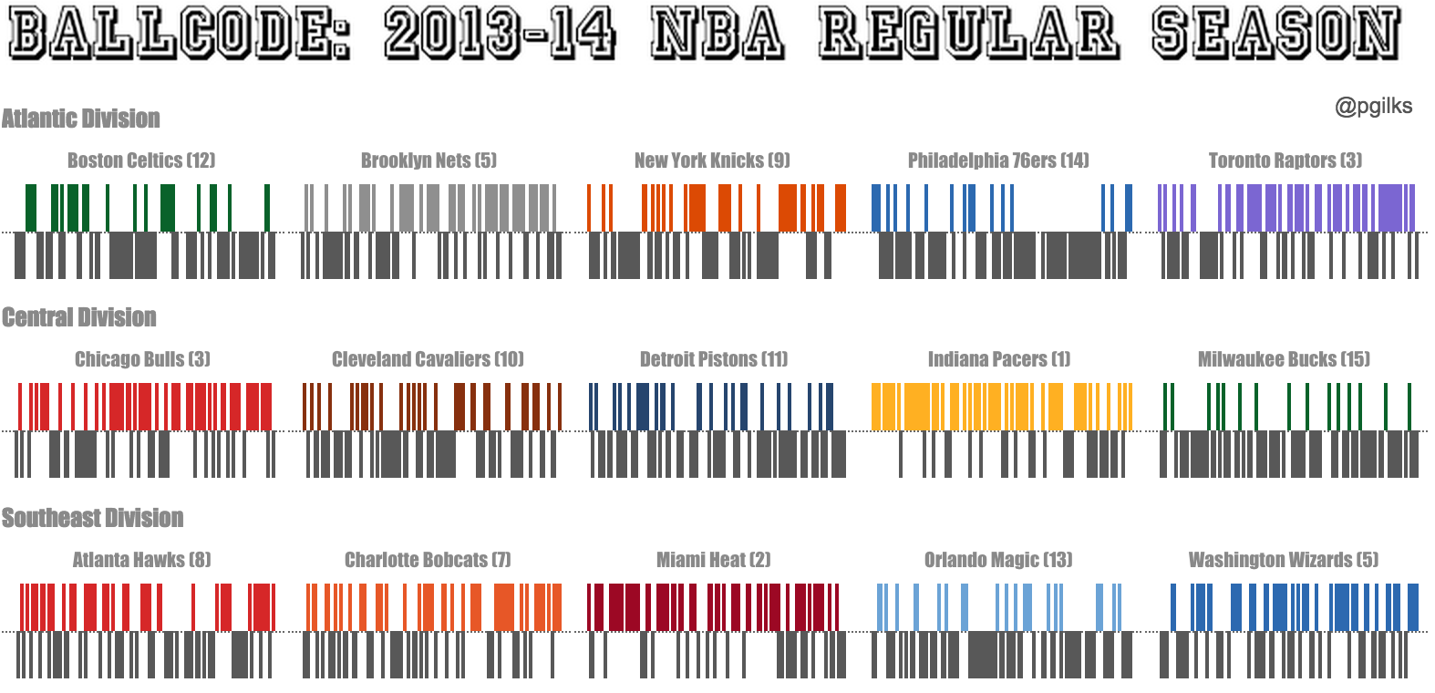
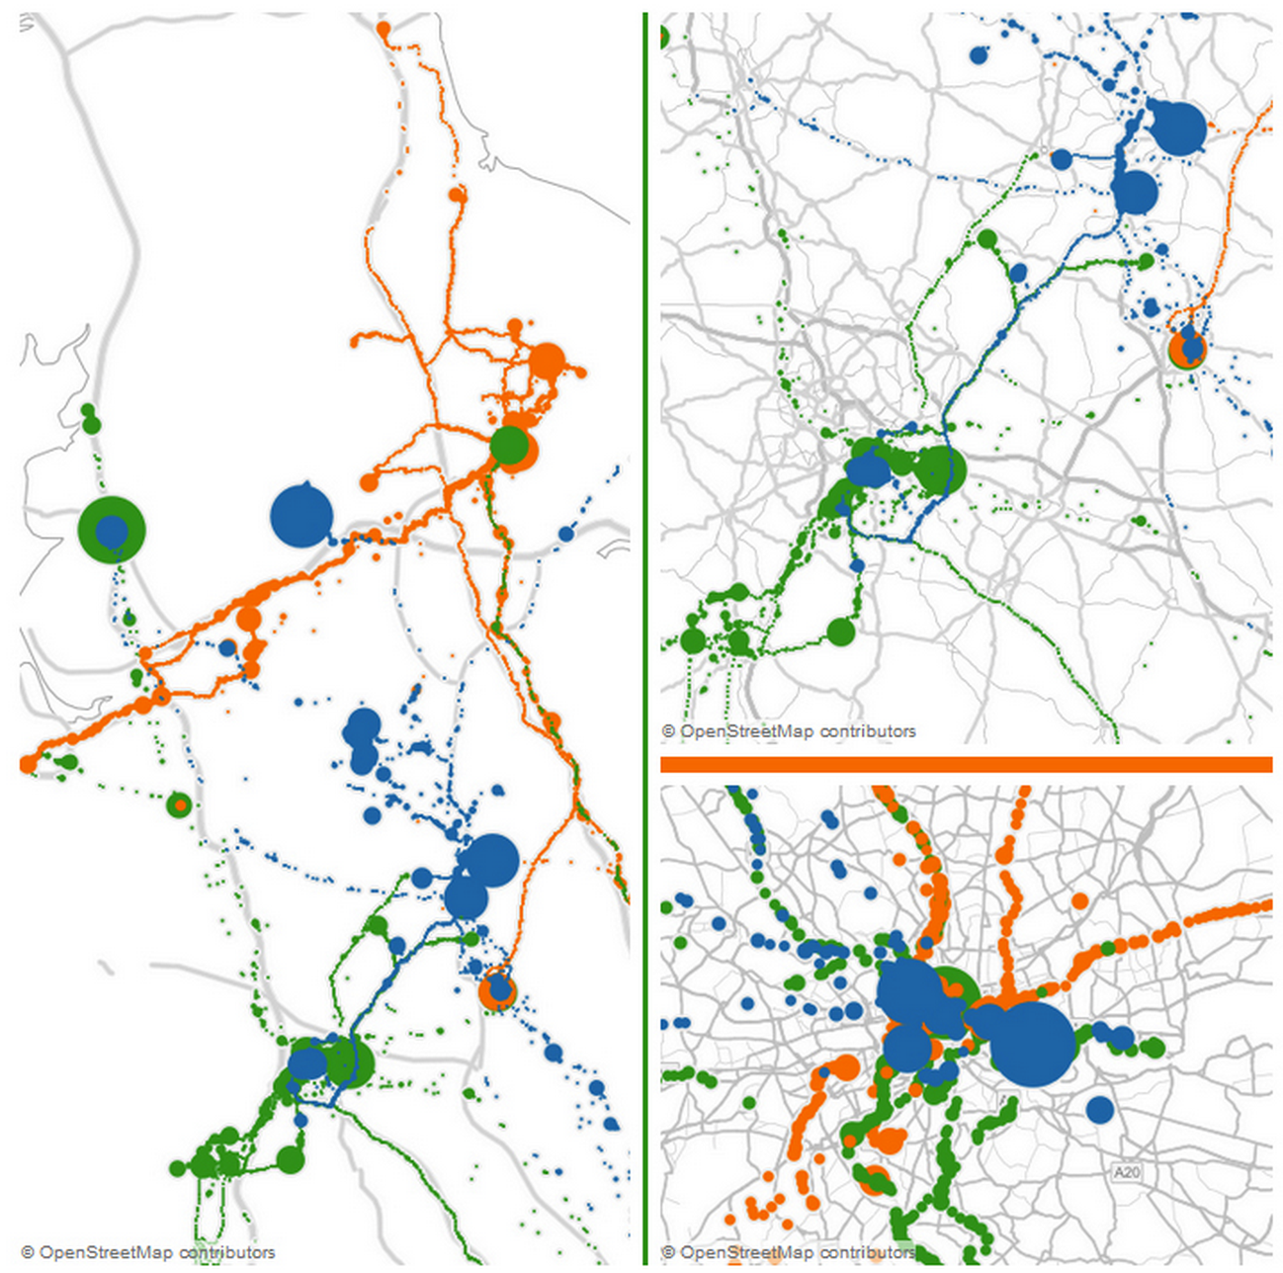
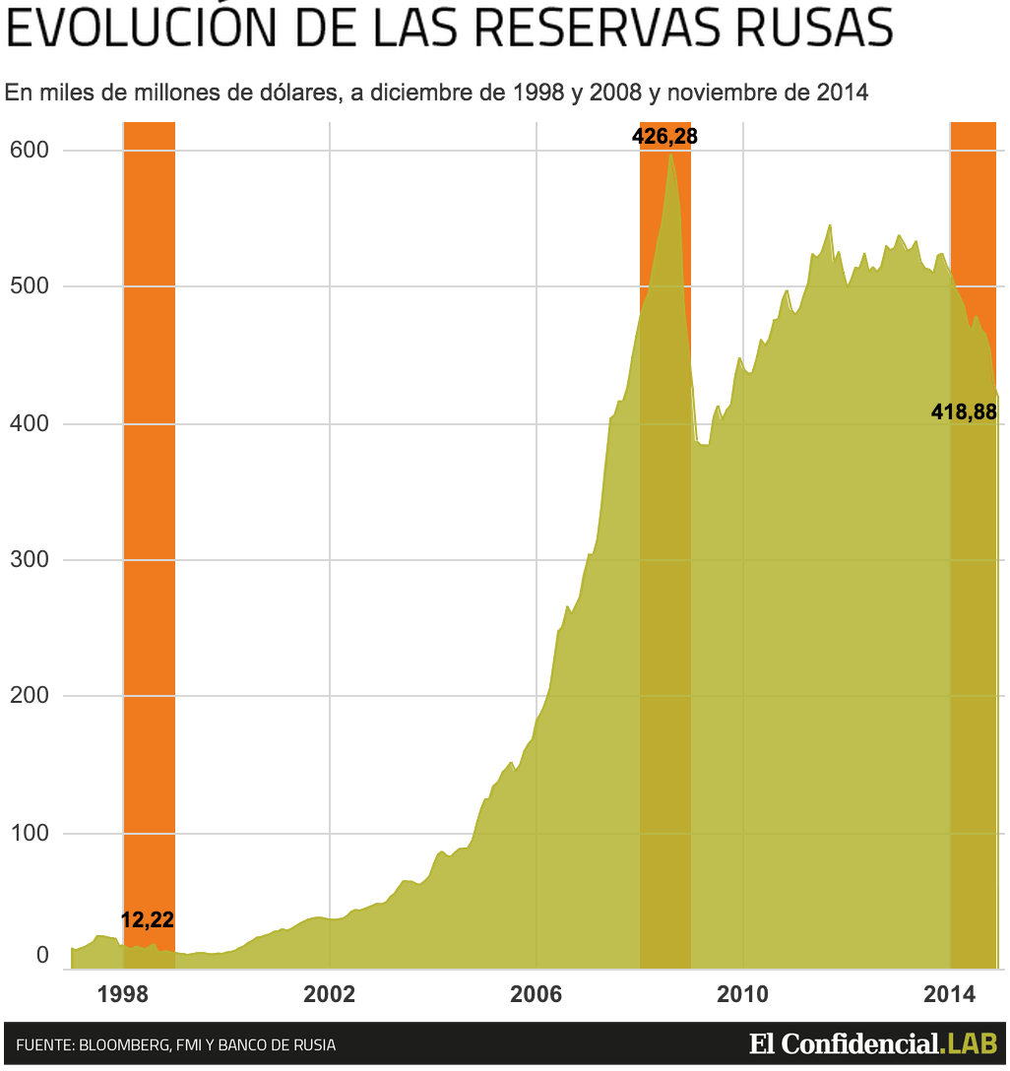
Notes:
EXPRESSIVE (Principle #2)
A conversation among people is expressive, and a conversation with data should be the same. You may be looking at something as mundane as the travel of consultants, and it is still important that you can shape that data in a way that you can connect to. The expressiveness of data is no less important than the expressiveness of art. Imagine if all creativity had to be channeled only through words, or only through painting or music…
Who would picture the Belarusian meat industry with whimsical icons and the title Molchanie yagniat—Silence of the Lambs? Or that an entire season of a sports league’s games could be painted like some abstract bar codes? Something as rich and expressive as the world’s data needs an expressive palette to represent it.

Slide 73

Notes:
UNIFIED (Principle #3)
A conversation also needs to get to the heart of its topic. For data, this means that you converse directly with the database. All the give and take of a data conversation, all the expressive views—all of this is loaded directly on tthe underlying data, whether it is an immense server farm or a small text file. Again, Tableau is not some intermediary, trying to force its way into the middle of a discussion. We help the conversation and get out of the way.

Slide 74
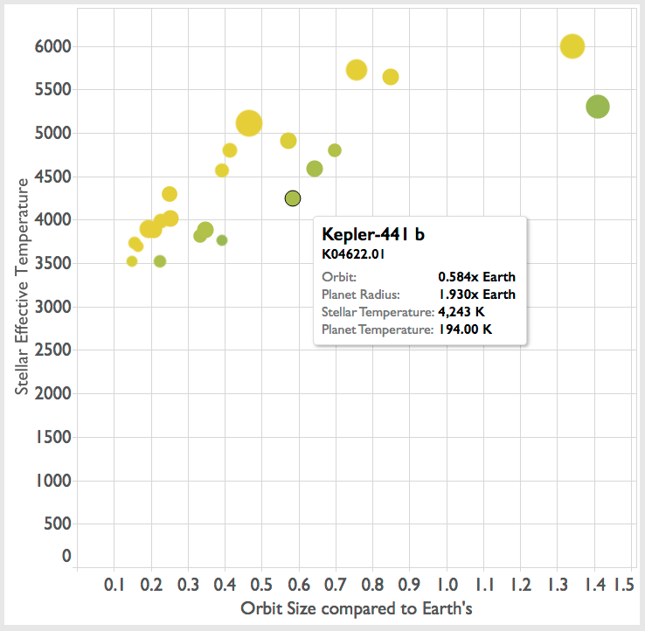
Notes:
DIRECT (Principle #4)
Finally, one thing we haven’t talked about much today is that Tableau gives our users an interactive surface. We are not just creating static data visualizations that our users can see, but live views that support tooltips, highlighting, filtering… ways to reach out and touch the data and ask it questions without even dragging and dropping.

Slide 75

Notes:
Before we wrap up, I wanted to talk a little about the history that got us here, too. Humanity has long used tools before having the science to explain why they work. We used fire and the wheel for millennia before we understood exothermic chemical reactions or physical laws. So let’s step back in time before we studied pre-attentive attributes and the counting center in the brain.
Over 500 years ago, white men from Europe arrived in the Marshall Islands, in Micronesia, in the middle of the Pacific Ocean. The Marshall Islands are miles from each other. Standing on the shore, all you can see is ocean. Yet the Marshallese navigators would climb into canoes and paddle without error from one island to another. They didn’t use paper maps, compasses, sextants, or even the stars to guide their way.
To the white men, this was nothing short of magic. Over time, we learned from these navigators that when they knelt in the front of their canoes they could see and feel the shape of the ocean. The interference patterns of the waves, rocking the boat carried the secrets of the currents as they shifted through the islands and the way the water would deflect off the long, submerged slopes of the island shores.
How did these navigators learn their techniques? In part, through practice, no doubt. But they also used data visualization.

Slide 76
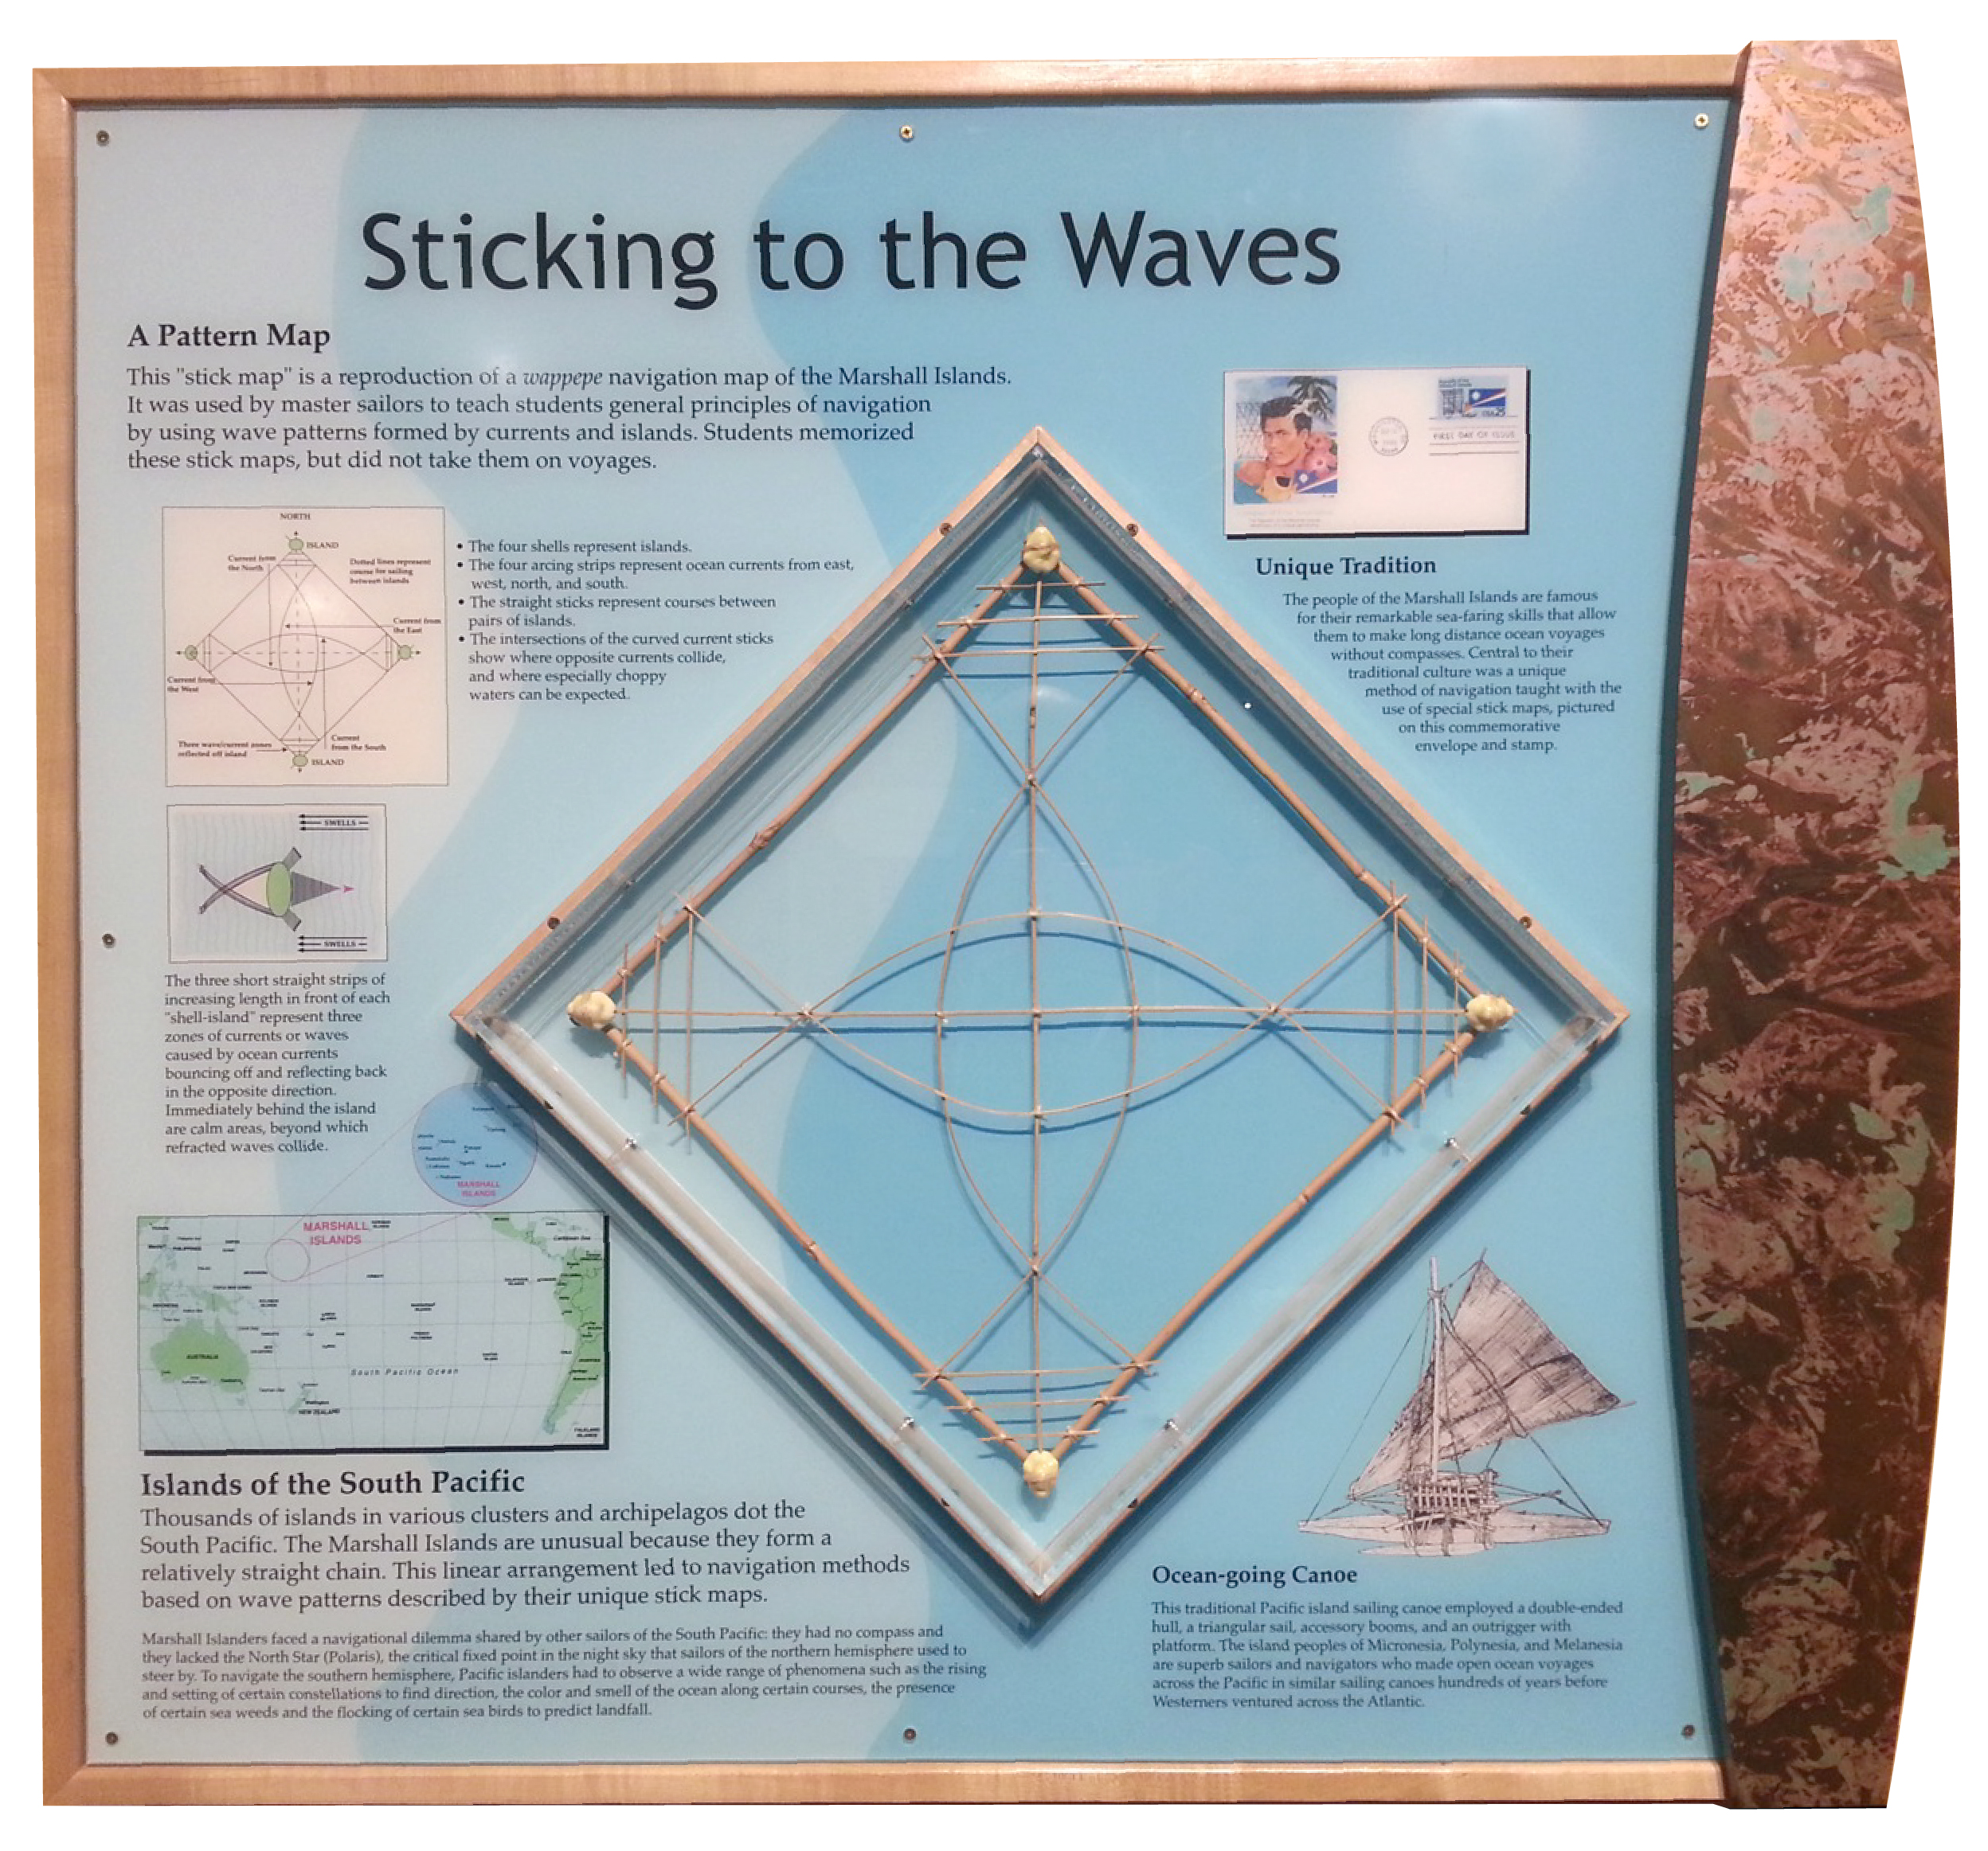
Notes:
This display, from the Museum of Science in Boston shows a stick map. Built from coconut fiber and rocks or shells, it is a TEACHING TOOL. This map represents a fictitious set of water movement through a made-up set of islands. In other words, this is sample data (or INTERNAL: the SUPERSTORE of the Marshall Islands). This curve here represents the current coming from the right there are three other curves representing more currents from other directions. These four rocks represent islands.
Accomplished navigators used tools like this one to teach the principles of Marshallese navigation to their apprentices.

Slide 77
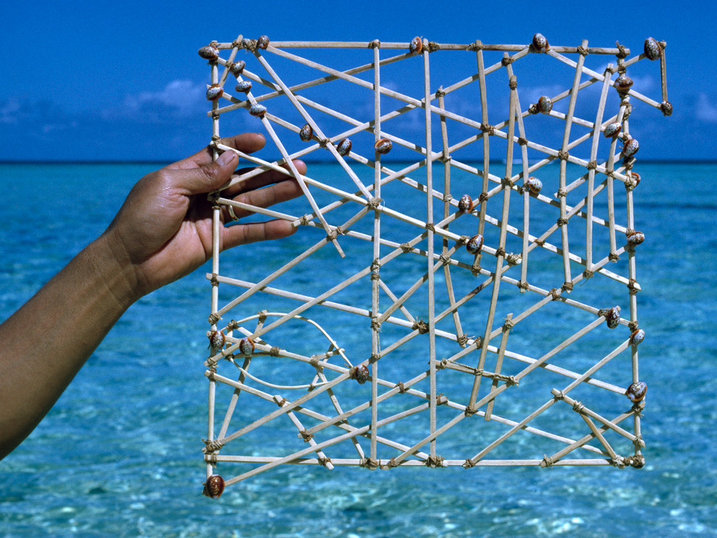
Photograph by Walter Meayers Edwards, http://education.nationalgeographic.com/education/media/micronesian-stick-chart/?ar_a=1
Notes:
A complete stick map might look like this. What’s most interesting is that these complex data visualizations were often NOT shared among navigators. They were reference tools created by a navigator for personal use. I suspect that once someone created the first one of these, someone else noticed it and said, “Hey, what’s that you got there?” And the idea spread from island to island… (Or INTERNAL: I think this was the first example of Land and Expand.)
But now, today, we don’t just have charts and graphs--we have the science behind them. We have started to unlock the principles of perception and cognition so we can apply them in new ways. When humanity unlocked the science behind fire and the wheel, we learned to harness chemistry and physics in new ways, and we revolutionized the world with steam engines, internal combustion vehicles, and more. Humanity is at the dawn of a new revolution now, and we are the team putting the beautiful science of data visualization into the hands of millions of users.
I’m excited to see where you take all of us next.

Slide 78
My Story Course Introduction Today’s Lesson: The Irony of the Mind Discussion Homework

Slide 79
Do you think Data Visualization should be further as an accepted norm than it is now? Yes? No? Why?
Discussion/Reflection

Slide 80
Analysts believe the highest and best use of their time and brain cells is to do quantitative analysis.
1
Notes:
To indulge in storytelling, some analysts may believe, is an insult—or at least a relatively less valuable investment of time in comparison—to an analysts’ technical capabilities. Capable quantitative analysts may justifiably argue that many people can tell good stories, but relatively few can run a logistical regression model with heteroskedasticity corrections. They may feel that the highest and best use of their time and brain cells is to do quantitative analysis, and to rely on others to tell stories about it. They may have a point, but relying on others to translate analytical results into stories has some perils of its own, in addition to being more labor-intensive.

Slide 81
Articulating compelling stories to other humans may not come naturally to many analysts.
2
Notes:
So why are individuals and organizations so bad at telling stories with data? Let us count the reasons:
Analytics people often aren’t that motivated or successful at communicating with carbon-based life forms. They gravitated toward structured, unambiguous, unchanging fields like math and statistics and computer science in school, and they continue to favor interaction with numbers over interaction with humans in their work careers. Of course, not all quantitative analysts are of this persuasion, and someone with a strong numerical focus can transition over time to be more human and literary in their orientations. But let’s just acknowledge that telling compelling stories to other humans may not come naturally to many analysts.

Slide 82
Analysts don’t get a lot of instruction on telling stories while in school.
3
Notes:
If analysts don’t gravitate naturally toward storytelling, they probably don’t get a lot of instruction on it in school either. Many college faculty members teaching quantitative courses are themselves not terribly good at storytelling. And they may feel that it’s more important to impart more instruction on methods than to “waste time” on storytelling approaches. This is incorrect, however, from the customer’s perspective; a survey (see this link for a summary–http://www.statslice.com/wp-content/uploads/2013/03/State-of-Academics-My-Article.pdf) of about 400 recruiters of analytical college graduates found that the highest-ranked of all desired skills was communication.

Slide 83
It takes a lot of analysts’ time to think creatively about how to tell a good story with data.
4
Notes:
It takes a lot of analysts’ time to think creatively about how to tell a good story with data. In fact, one senior analyst at a pharmaceutical company told me that he (and most members of his analytics group) spend about half their time thinking about how best to communicate their analytical results. Many analysts will be reluctant to devote that much time to the issue, even if it would make them more effective.

Slide 84
5
The analyst’s organization is slow to change and accept new ways of doing things.
Notes:
If any of you have worked in non-profits, in large enterprises, in the federal government, or even are just in tune with yourself, you realize that change often looks like…

Slide 85

Notes:
The reality is that Tableau doesn’t change any of this. Change is still incredibly hard to push through a bureaucracy. Its hard because people like what they are comfortable with. And the REALLY like what they are comfortable with, with data. If they like an excel sheet they are going to hold onto it as long as they can.
Tableau doesn’t really change that. What it does do is allow for a different vehicle, a vehicle to tell stories with data. When you do it right, get the right kind of buy in, use the right kind of visualizations you can really push through change.
I get it. I’m in the same boat. When it comes to analyzing data that is my sweet spot. But when it comes to communicating data, telling a story. I fall into the same trap that a lot of you might fall into. I assemble the building blocks. 1, 2, 3, 4, 5. I have all these building blocks. And I’m going to try to convience someone to come to the same conclusion that I came to. But instead of telling them, I’m just going to give them all the building blocks and I am going to run away. So rather than doing that, it is important to give them the building blocks, AND also tell them what that point is. It can feel awkward.

Slide 86
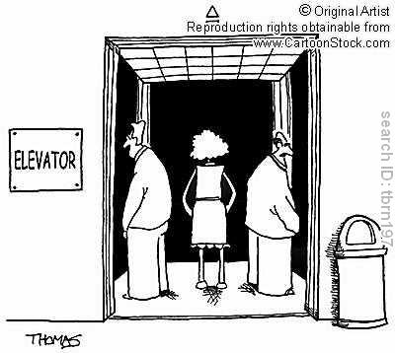
Notes:
But it is important skill to develop as an analyst. So I want to applaud you all for being here. For being willing to step outside your comfort zone and learn. It is a huge skill set and not something you will develop overnight. There are people who spend their entire lives learning to be storytellers, and what makes stories compelling.

Slide 87
What challenges does data visualization need to overcome for more widespread use?
Discussion/Reflection

Slide 88
My Story Course Introduction Today’s Lesson: The Irony of the Mind Discussion Homework
Notes:
In a recent talk at the SEE conference in Germany, data illustrator Stefanie Posavecopened her talk with a sobering observation about how she had found the data visualization field really intimidating.
Her experience was that many visualization bloggers and active participants seem to believe in one right way and lots of wrong ways to create a visualization. To those entering the field, these types of views will create a fair amount of confusion, inconsistency and contradiction. It demonstrates our current glass-is-never-full tendency toward critical evaluation.
Many express a frustration in their struggle to understand and identify what makes a perfect visualization. By extension, they admit to a difficulty in establishing clarity in their own convictions about judging what is a right way and a wrong way to approach a visualization design.
Entering the field, you begin with fundamentally no informed reasoning for appreciation of quality; it is a gut instinct based on the effect it has on you. Yet, through the influence of reading key articles and exposure to social media, when you see others expressing a conviction, you feel obliged to jump off the fence and hurriedly wave a flag, any flag, of your judgment. It’s not so much a case of following the crowd, rather more about feeling a need to express an opinion as quickly and as clearly as everybody else seems to.
Here’s the truth: Developing clarity of your design conviction is difficult. If it were purely about taste, it would be easier. That’s why you can be much more affirmative about your tastes in things like music, art or movies. “Did it connect with you?” is a very open but fitting question that easily allows you to arrive at a Boolean type of response and the clarity of your judgment.

Slide 89
1. Select A Data Visualization (Kriebel’s Makeover Monday) 2. Critique the Visualization - Focus on what works - What doesn't work - Why those things don't work - How you would make it better 3. Submit to discussion board with a link to the visualization. BONUS: Put your ideas to paper and build a visualization.
Optional (Highly Encouraged) Assignment #1
Notes:
From Andy Kriebel’s Makeover Monday
http://vizwiz.blogspot.co.uk/p/makeover-monday-challenges.html
Reading on Critiquing:
Design and redesign by Fernanda Vegas and Martin Wattenberg
Walking the tightrope of visualization criticism by Andy Kirk
What’s happened to the trust? Also by Andy Kirk

Slide 90
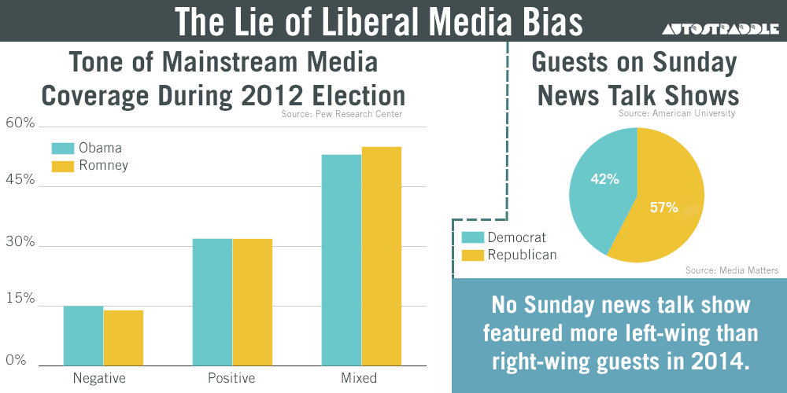
Notes:
Sometimes the very source of a visualization causes us to
This also raises a point about our own opinions and beliefs.
I was talking with Andy CroI am not a fan of the Daily Mail. I don’t agree with its politics or approach to journalism. Did that cloud my reaction to the chart before I even looked at it? If this had been in the Guardian, would I have been fairer? I suspect the answer is yes to both those questions.
Here’s what I need to remember: MakeoverMonday is about building positive conversations. We find vizzes with great data which we feel could be improved in some way. The intention is to generate conversation, not upset the creators.
At the Tapestry conference several weeks ago Enrico Bertini said something perfectly captures what I think Data Visualization is about: “Use data visualization to generate ideas not truth. Data visualization is a creativity tool.”
Although Data Visualization is still evolving The variety of perspectives we see based on all the contributions prove that.
There have been many great articles about how our community should critique visualisations. I recommend you read them all:
Design and redesign by Fernanda Vegas and Martin Wattenberg
Walking the tightrope of visualization criticism by Andy Kirk
What’s happened to the trust? Also by Andy Kirk

Slide 91
Thank You

